Slide 1
22
Standard Template Library (STL)

Slide 2
The shapes a bright container can contain!
  Theodore Roethke
Journey over all the universe in a map.
  Miguel de Cervantes
O! thou hast damnable iteration, and art indeed able to corrupt a saint.
  William Shakespeare
That great dust heap called “history.”
  Augustine Birrell
The historian is a prophet in reverse.
  Friedrich von Schlegel
Attempt the end, and never stand to doubt; Nothing's so hard but search will find it out.
  Robert Herrick

Slide 3
OBJECTIVES
In this chapter you’ll learn:
To use the template STL containers, container adapters and "near containers."
To program with the dozens of STL algorithms.
To understand how algorithms use iterators to access the elements of STL containers.
To become familiar with the STL resources available on the Internet and the World Wide Web.

Slide 4
22.1 Introduction to the Standard Template Library (STL)
22.1.1 Introduction to Containers
22.1.2 Introduction to Iterators
22.1.3 Introduction to Algorithms
22.2 Sequence Containers
22.2.1 vector Sequence Container
22.2.2 list Sequence Container
22.2.3 deque Sequence Container
22.3 Associative Containers
22.3.1 multiset Associative Container
22.3.2 set Associative Container
22.3.3 multimap Associative Container
22.3.4 map Associative Container
22.4 Container Adapters
22.4.1 stack Adapter
22.4.2 queue Adapter
22.4.3 priority_queue Adapter

Slide 5
22.5 Algorithms
22.5.1 fill, fill_n, generate and generate_n
22.5.2 equal, mismatch and lexicographical_compare
22.5.3 remove, remove_if, remove_copy and remove_copy_if
22.5.4 replace, replace_if, replace_copy and replace_copy_if
22.5.5 Mathematical Algorithms
22.5.6 Basic Searching and Sorting Algorithms
22.5.7 swap, iter_swap and swap_ranges
22.5.8 copy_backward, merge, unique and reverse
22.5.9 inplace_merge, unique_copy and reverse_copy
22.5.10 Set Operations
22.5.11 lower_bound, upper_bound and equal_range
22.5.12 Heapsort
22.5.13 min and max
22.5.14 STL Algorithms Not Covered in This Chapter

Slide 6
22.6 Class bitset
22.7 Function Objects
22.8 Wrap-Up
22.9 STL Internet and Web Resources

Slide 7
22.1 Introduction to the Standard Template Library (STL)
Standard Template Library (STL)
  Defines powerful, template-based, reusable components and algorithms to process them
    Implements many common data structures
  Developed by Alexander Stepanov and Meng Lee
  Conceived and designed for performance and flexibility
  Three key components
    Containers
    Iterators
    Algorithms

Slide 8
Performance Tip 22.1
For any particular application, several different STL containers might be appropriate. Select the most appropriate container that achieves the best performance (i.e., balance of speed and size) for that application. Efficiency was a crucial consideration in STL’s design.

Slide 9
Performance Tip 22.2
Standard Library capabilities are implemented to operate efficiently across many applications. For some applications with unique performance requirements, it might be necessary to write your own customized implementations.

Slide 10
22.1 Introduction to the Standard Template Library (STL) (Cont.)
STL containers
  Three container categories
    First-class containers
    Adapters
    Near containers
  Each container has associated member functions
    Some member functions are defined in all STL containers

Slide 11
22.1 Introduction to the Standard Template Library (STL) (Cont.)
STL iterators
  Used to manipulate STL-container elements
    Similar to pointers
  Standard pointers can be used as iterators
    So standard arrays can be manipulated as STL containers

Slide 12
22.1 Introduction to the Standard Template Library (STL) (Cont.)
STL algorithms
  Perform common data manipulations such as searching, sorting and comparing
  Mostly use iterators to access container elements
    Each algorithm has minimum iterator requirements
      Can be used on any container whose supported iterator type satisfies those requirements

Slide 13
Software Engineering Observation 22.1
The STL approach allows general programs to be written so that the code does not depend on the underlying container. Such a programming style is called generic programming.

Slide 14
Software Engineering Observation 22.2
Avoid reinventing the wheel; program with the reusable components of the C++ Standard Library. STL includes many of the most popular data structures as containers and provides various popular algorithms to process data in these containers.

Slide 15
Error-Prevention Tip 22.1
When programming pointer-based data structures and algorithms, we must do our own debugging and testing to be sure our data structures, classes and algorithms function properly. It is easy to make errors when manipulating pointers at this low level. Memory leaks and memory-access violations are common in such custom code. For most programmers, and for most of the applications they will need to write, the prepackaged, templatized containers of the STL are sufficient. Using the STL helps programmers reduce testing and debugging time. One caution is that, for large projects, template compile time can be significant.

Slide 16
22.1.1 Introduction to Containers
STL containers
  Three major categories
    Sequence containers
      Represent linear data structures
    Associative containers
      Nonlinear containers
      Store key/value pairs
    Container adapters
      Implemented as constrained sequence containers
  “Near-containers”
    Pointer-based arrays, strings, bitsets and valarrays

Slide 17
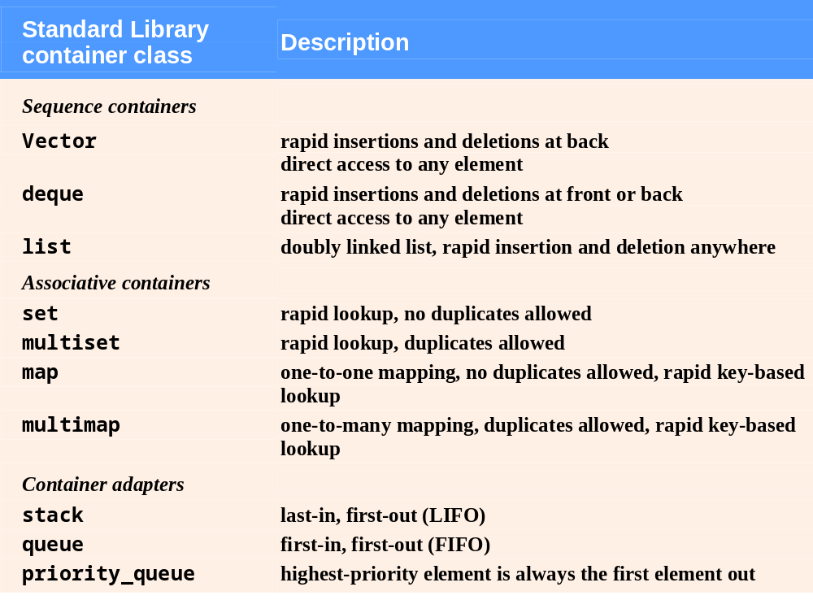
Fig. 22.1 | Standard Library container classes.

Slide 18
22.1.1 Introduction to Containers (Cont.)
STL containers (Cont.)
  Common functions
    All STL containers provide similar functionality
    Many generic operations apply to all containers
    Others apply of subsets of similar containers
  Header files
    STL containers are found in various header files
    STL containers are all in namespace std

Slide 19
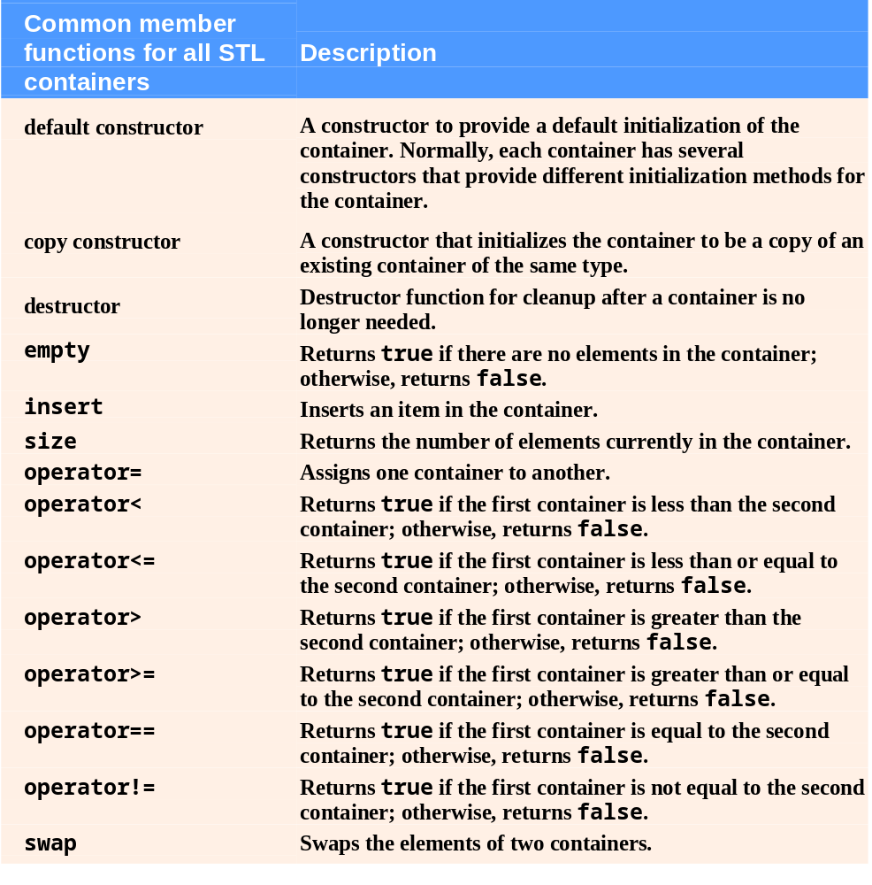
Fig. 22.2 | STL container common functions. (Part 1 of 2)

Slide 20
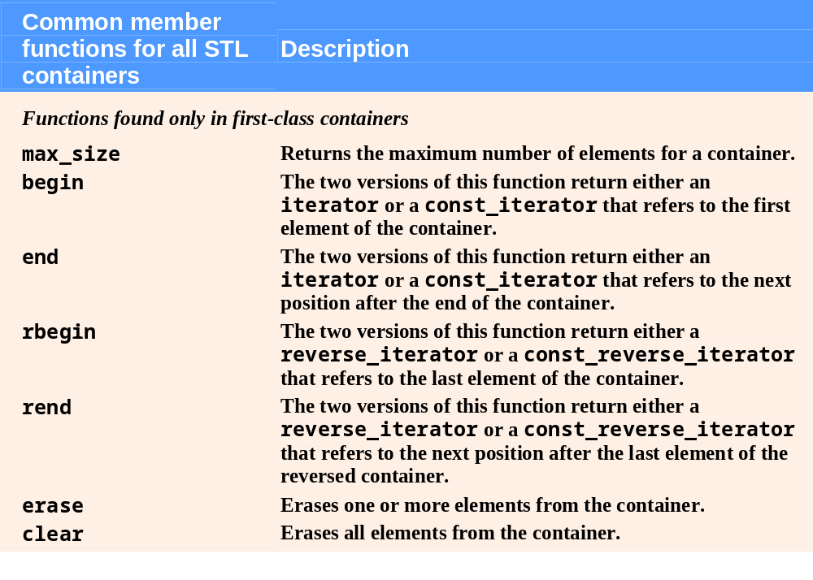
Fig. 22.2 | STL container common functions. (Part 2 of 2)

Slide 21
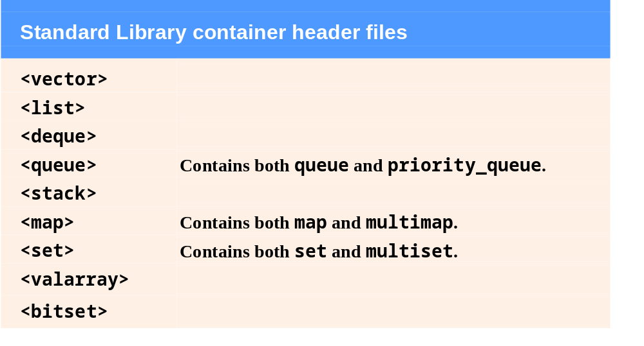
Fig. 22.3 | Standard Library container header files.

Slide 22
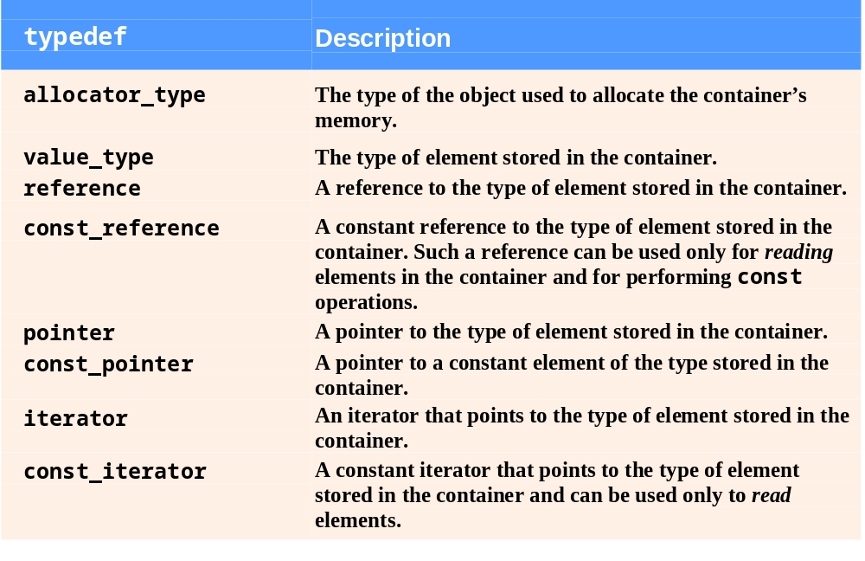
Fig. 22.4 | typedefs found in first-class containers. (part 1 of 2)

Slide 23
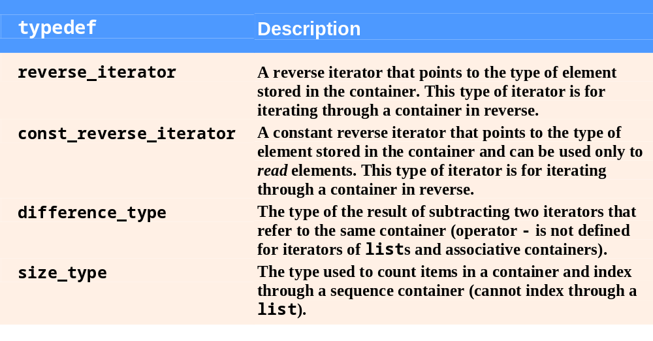
Fig. 22.4 | typedefs found in first-class containers. (part 2 of 2)

Slide 24
Performance Tip 22.3
STL generally avoids inheritance and virtual functions in favor of using generic programming with templates to achieve better execution-time performance.

Slide 25
Portability Tip 22.1
Programming with STL will enhance the portability of your code.

Slide 26
22.1.1 Introduction to Containers (Cont.)
STL containers (Cont.)
  Type requirements for STL container elements
    Elements must be copied to be inserted in a container
      Element’s type must provide copy constructor and assignment operator
        Compiler will provide default memberwise copy and default memberwise assignment, which may or may not be appropriate
    Elements might need to be compared
      Element’s type should provide equality operator and less-than operator

Slide 27
Software Engineering Observation 22.3
The STL containers technically do not require their elements to be comparable with the equality and less-than operators unless a program uses a container member function that must compare the container elements (e.g., the sort function in class list). Unfortunately, some prestandard C++ compilers are not capable of ignoring parts of a template that are not used in a particular program. On compilers with this problem, you may not be able to use the STL containers with objects of classes that do not define overloaded less-than and equality operators.

Slide 28
22.1.2 Introduction to Iterators
STL iterators
  Have many features in common with pointers
    Used to point to elements of first-class containers
    Dereferencing operator (*) accesses current element
    ++ operator moves iterator to next element of the container
  Hold state information for their particular containers
  First-class container member functions
    Member function begin
      Returns iterator pointing to first element
    Member function end
      Returns iterator pointing just past last element

Slide 29
22.1.2 Introduction to Iterators (Cont.)
STL iterators (Cont.)
  iterator versus const_iterator
    const_iterators cannot modify container elements
  Iterators are used with sequences (also called ranges)
    Sequences can be in containers
    Sequences can be input or output sequences
      istream_iterator
        An iterator for an input sequence
      ostream_iterator
        An iterator for an output sequence

Slide 30
Error-Prevention Tip 22.2
The * (dereferencing) operator of any const iterator returns a const reference to the container element, disallowing the use of non-const member functions.

Slide 31
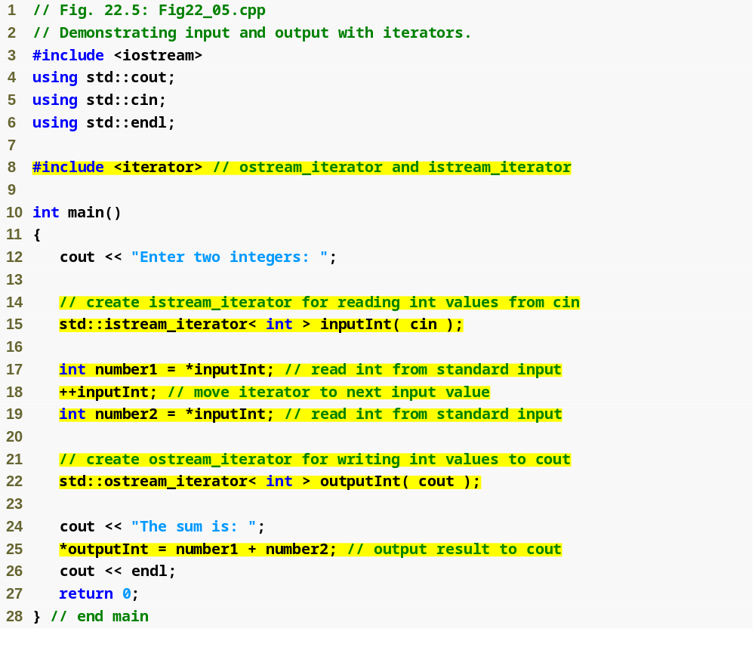
Outline
Fig22_05.cpp
(1 of 2)
Create an istream_iterator capable of extracting int values from standard input cin
Dereference istream_iterator inputInt to read an int from cin
Position istream_iterator inputInt to the next value in the input stream
Create an ostream_iterator capable of inserting int values into standard output cout
Dereference outputInt and use it as an lvalue to output an integer to cout

Slide 32
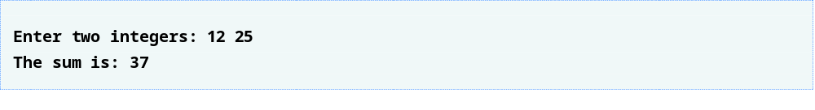
Outline
Fig22_05.cpp
(2 of 2)

Slide 33
Common Programming Error 22.1
Attempting to dereference an iterator positioned outside its container is a runtime logic error. In particular, the iterator returned by end cannot be dereferenced or incremented.

Slide 34
Common Programming Error 22.2
Attempting to create a non-const iterator for a const container results in a compilation error.

Slide 35
22.1.2 Introduction to Iterators (Cont.)
STL iterators (Cont.)
  Iterator categories
    Input – can move forward one position, can read elements
    Output – can move forward one position, can write elements
    Forward – can move forward one position, can read and write elements
    Bidirectional – can move forward or backward one position, can read and write elements
    Random access – can move forward or backward any number of positions, can read and write elements
  Each category supports all functionality of categories above it in Fig. 22.7
  Iterator category determines what algorithms can be used

Slide 36
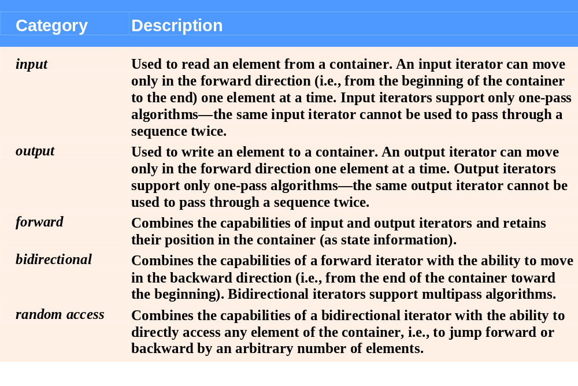
Fig. 22.6 | Iterator categories.

Slide 37

Fig. 22.7 | Iterator category hierarchy.

Slide 38
Software Engineering Observation 22.4
Using the “weakest iterator” that yields acceptable performance helps produce maximally reusable components. For example, if an algorithm requires only forward iterators, it can be used with any container that supports forward iterators, bidirectional iterators or random-access iterators. However, an algorithm that requires random-access iterators can be used only with containers that have random-access iterators.

Slide 39
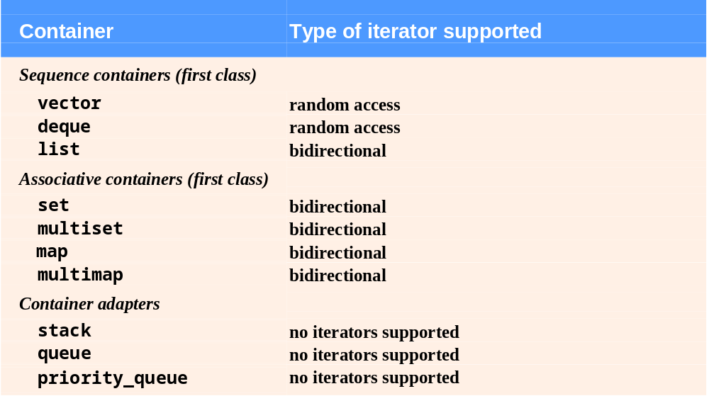
Fig. 22.8 | Iterator types supported by each Standard Library container.

Slide 40
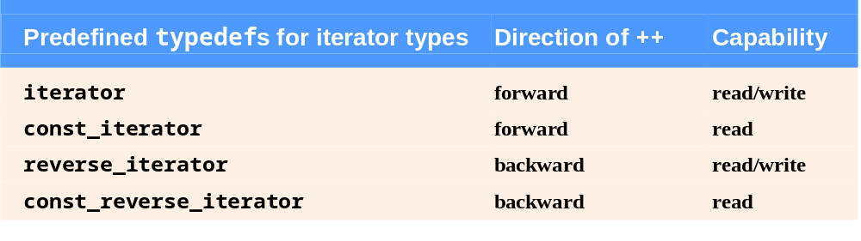
Fig. 22.9 | Iterator typedefs.

Slide 41
Error-Prevention Tip 22.3
Operations performed on a const_iterator return const references to prevent modification to elements of the container being manipulated. Using const_iterators in preference to iterators where appropriate is another example of the principle of least privilege.

Slide 42
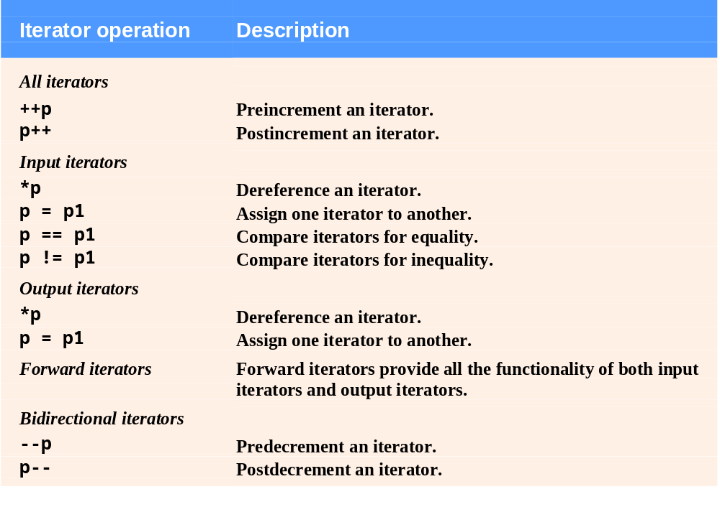
Fig. 22.10 | Iterator operations for each type of iterator. (Part 1 of 2 )

Slide 43
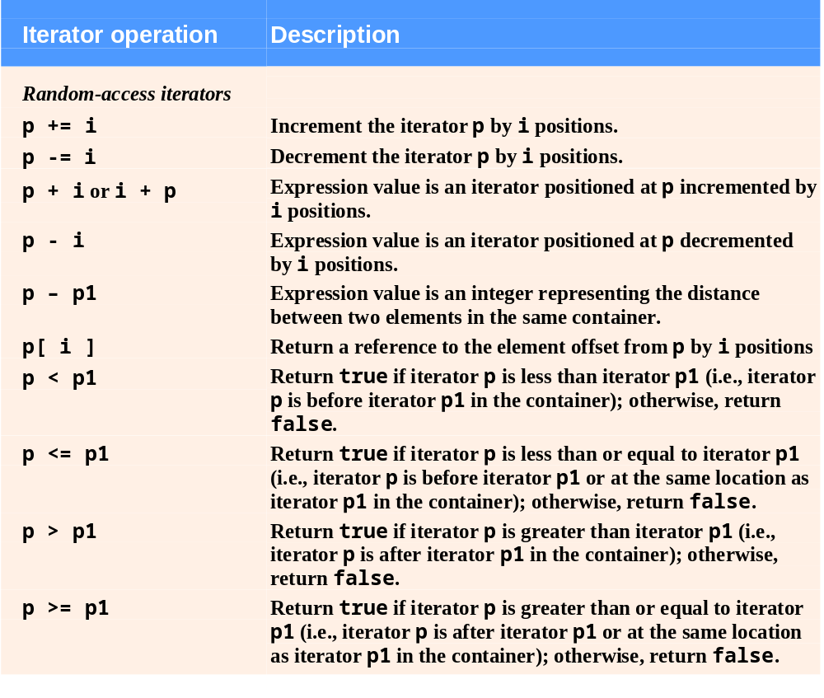
Fig. 22.10 | Iterator operations for each type of iterator. (Part 2 of 2 )

Slide 44
22.1.3 Introduction to Algorithms
STL algorithms
  Can be used generically across many containers
    Inserting, deleting, searching, sorting, etc.
  Operate on container elements only indirectly through iterators
    Many operate on sequences defined by pairs of iterators
      First iterator points to first element of sequence
      Second iterator points one past last element of sequence
    Often return iterators to indicate results
    Can be used on containers that support the necessary iterator, or containers that support more powerful iterators

Slide 45
Software Engineering Observation 22.5
The STL is implemented concisely. Until now, class designers would have associated the algorithms with the containers by making the algorithms member functions of the containers. The STL takes a different approach. The algorithms are separated from the containers and operate on elements of the containers only indirectly through iterators. This separation makes it easier to write generic algorithms applicable to many container classes.

Slide 46
Software Engineering Observation 22.6
The STL is extensible. It is straightforward to add new algorithms and to do so without changes to STL containers.

Slide 47
Software Engineering Observation 22.7
STL algorithms can operate on STL containers and on pointer-based, C-like arrays.

Slide 48
Portability Tip 22.2
Because STL algorithms process containers only indirectly through iterators, one algorithm can often be used with many different containers.

Slide 49
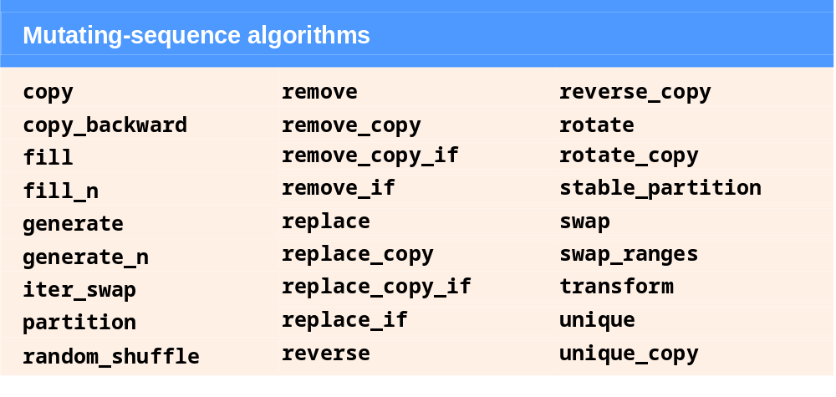
Fig. 22.11 | Mutating-sequence algorithms.

Slide 50
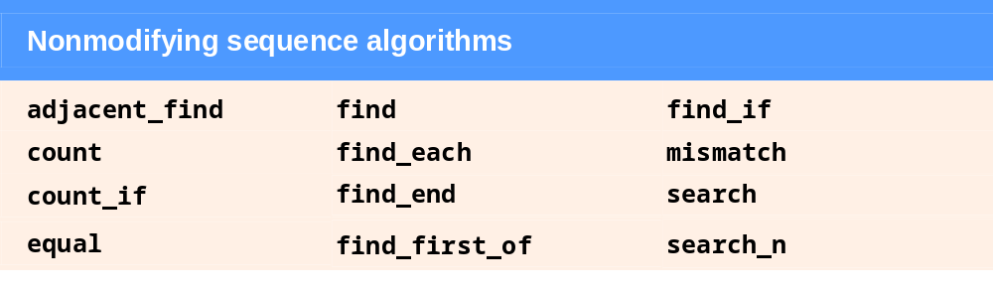
Fig. 22.12 | Nonmutating sequence algorithms.

Slide 51
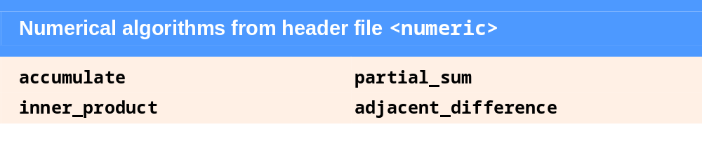
Fig. 22.13 | Numerical algorithms from header file <numeric>.

Slide 52
22.2 Sequence Containers
STL sequence containers
  Three sequence containers
    vector – a more robust type of array
    list – implements a linked-list data structure
    deque – based on arrays
  Common operations of sequence containers
    front returns reference to first element
    back returns reference to last element
    push_back inserts new element to the end
    pop_back removes last element

Slide 53
Performance Tip 22.4
Insertion at the back of a vector is efficient. The vector simply grows, if necessary, to accommodate the new item. It is expensive to insert (or delete) an element in the middle of a vector—the entire portion of the vector after the insertion (or deletion) point must be moved, because vector elements occupy contiguous cells in memory just as C or C++ “raw” arrays do.

Slide 54
Performance Tip 22.5
Applications that require frequent insertions and deletions at both ends of a container normally use a deque rather than a vector. Although we can insert and delete elements at the front and back of both a vector and a deque, class deque is more efficient than vector for doing insertions and deletions at the front.

Slide 55
Performance Tip 22.6
Applications with frequent insertions and deletions in the middle and/or at the extremes of a container normally use a list, due to its efficient implementation of insertion and deletion anywhere in the data structure.

Slide 56
22.2.1 vector Sequence Container
Class template vector
  A data structure with contiguous memory locations
    Efficient, direct access to any element via subscript operator
      Or member function at, which provides range-checking
  Commonly used when data must be sorted and easily accessible via indices (subscripts)
  When additional memory is needed
    Allocates larger contiguous memory, copies elements and deallocates old memory
  Supports random-access iterators
    All STL algorithms can operate on vectors
  Requires header file <vector>

Slide 57
Performance Tip 22.7
Choose the vector container for the best random-access performance.

Slide 58
Performance Tip 22.8
Objects of class template vector provide rapid indexed access with the overloaded subscript operator [] because they are stored in contiguous memory like a C or C++ raw array.

Slide 59
Performance Tip 22.9
It is faster to insert many elements at once than one at a time.

Slide 60
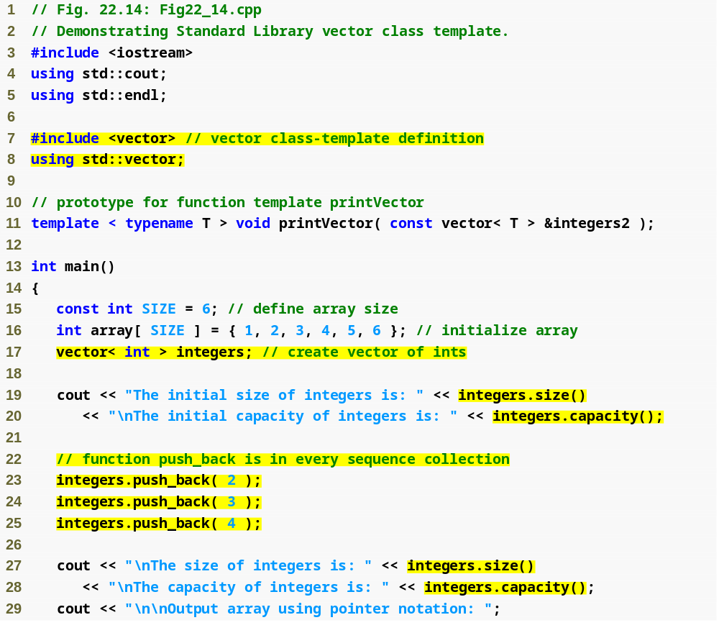
Outline
Fig22_14.cpp
(1 of 3)
Define a vector called integers that stores int values
Return the number of elements currently stored in the container
Return the number of elements that can be stored in the vector before it needs to dynamically resize itself to accommodate more elements
Add elements to the end of the vector

Slide 61
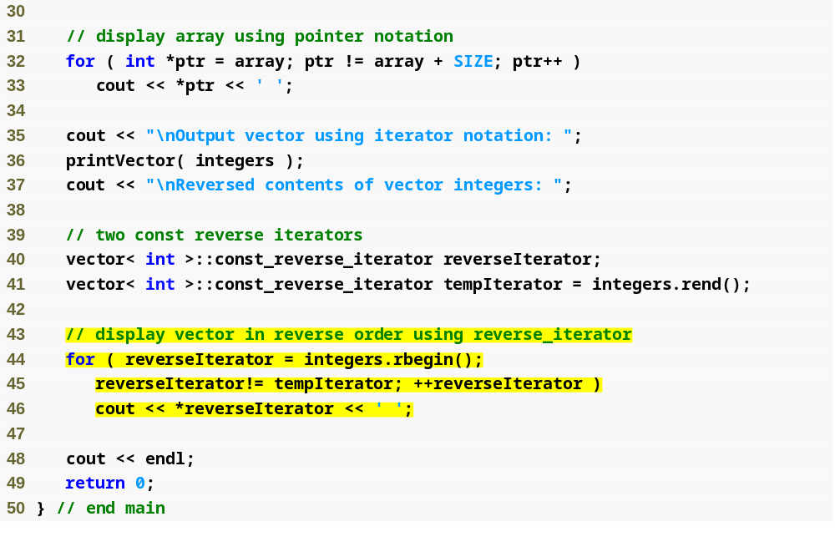
Outline
Fig22_14.cpp
(2 of 3)
reverseIterator iterates from the position returned by rbegin until just before the position returned by rend to output the vector elements in reverse order

Slide 62
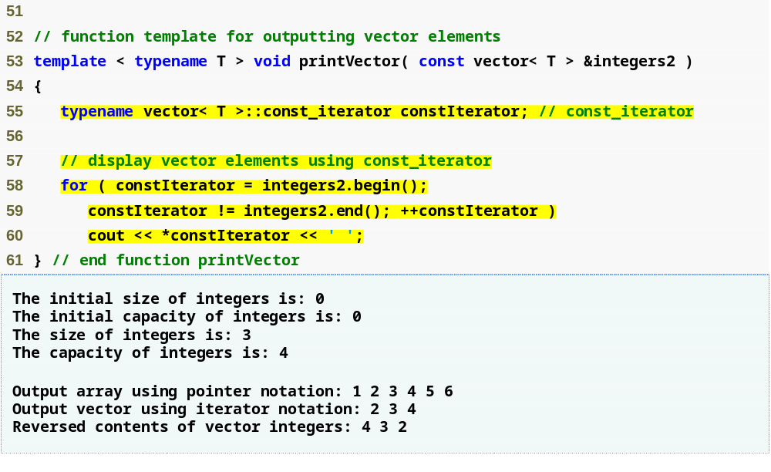
Outline
Fig22_14.cpp
(3 of 3)
Tell the compiler that vector< T > ::const_iterator is expected to be a type in every specialization
constIterator iterates through the vector and outputs its contents
The vector’s capacity increases to accommodate the growing size

Slide 63
Performance Tip 22.10
It can be wasteful to double a vector’s size when more space is needed. For example, a full vector of 1,000,000 elements resizes to accommodate 2,000,000 elements when a new element is added. This leaves 999,999 unused elements. Programmers can use resize to control space usage better.

Slide 64
Performance Tip 22.11
Use prefix increment when applied to STL iterators because the prefix increment operator does not return a value that must be stored in a temporary object.

Slide 65
22.2.1 vector Sequence Container (Cont.)
Class template vector (Cont.)
  Member function insert
    Inserts a value at location specified by iterator argument
    Overloaded versions
      Insert multiple copies of a value
      Insert a range of values from another container
  Member function erase
    Remove the element at location specified by iterator argument
    Or remove a range of elements specified by two iterator arguments

Slide 66
22.2.1 vector Sequence Container (Cont.)
STL algorithm function copy
  Copies each element in the specified container into the other specified container
    First and second arguments specify source container
      Must be at least input iterators
    Third argument specifies beginning of destination container
      Must be at least output iterator
  Requires header file <algorithm>

Slide 67
Error-Prevention Tip 22.4
Only random-access iterators support <. It is better to use != and end to test for the end of a container.

Slide 68
Performance Tip 22.12
For performance reasons, capture the loop ending value before the loop and compare against that, rather than having a (potentially expensive) function call for each iteration.

Slide 69
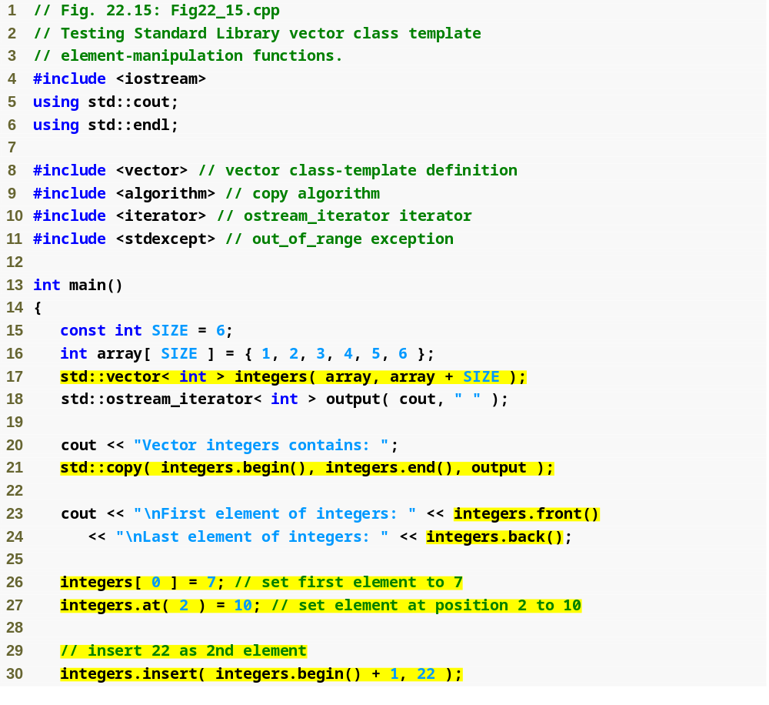
Outline
Fig22_15.cpp
(1 of 3)
<algorithm> must be included to use STL algorithms
Initialize integers with the contents of array from location array up to just before location array + SIZE
output can be used to output integers separated by single spaces via cout
Copy the entire contents of vector integers to the standard output
References to first and last elements of integers
Access individual elements of integers
Insert 22 as the second element

Slide 70
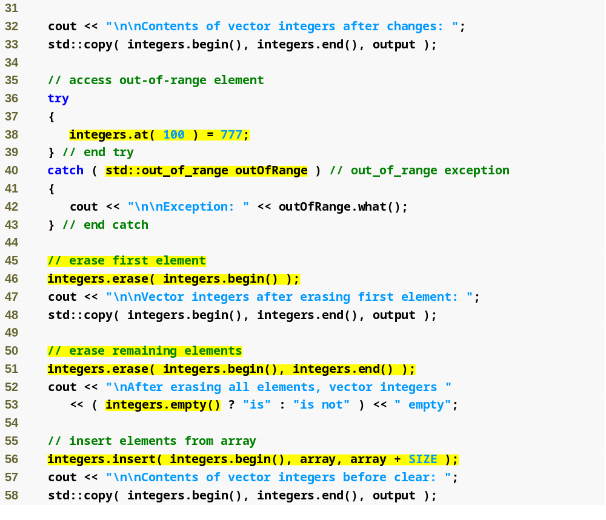
Outline
Member function at throws an out_of_range exception
Fig22_15.cpp
(2 of 3)
Remove the element at the beginning of integers
Erase all elements of integers
Confirm that the vector is empty
Insert all of array at the beginning of integers

Slide 71
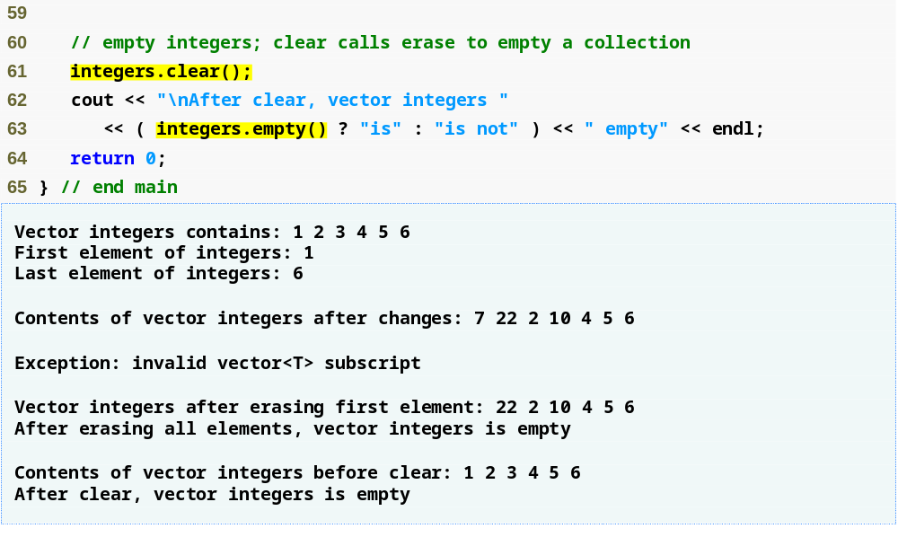
Outline
Empty the vector
Fig22_15.cpp
(3 of 3)

Slide 72
Common Programming Error 22.3
The vector must not be empty; otherwise, results of the front and back functions are undefined.

Slide 73
Common Programming Error 22.4
Erasing an element that contains a pointer to a dynamically allocated object does not delete that object; this can lead to a memory leak.

Slide 74
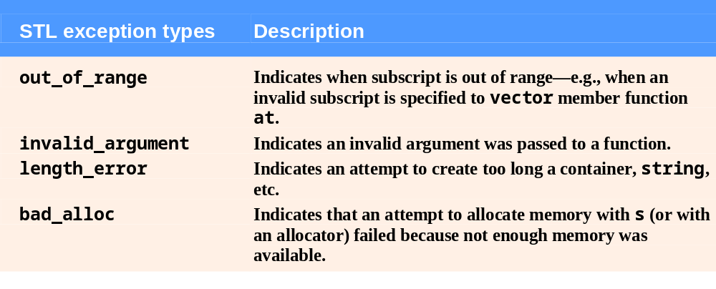
Fig. 22.16 | Some STL exception types.

Slide 75
22.2.2 list Sequence Container
Class template list
  Implemented as a doubly-linked list
    Provides efficient insertion and deletion operations at any location
  Supports bidirectional iterators
    Can be traversed forward and backward
  Requires header file <list>

Slide 76
22.2.2 list Sequence Container (Cont.)
Class template list (Cont.)
  Member function sort
    Arranges the elements in the list in ascending order
    Can take a binary predicate function as second argument to determine sorting order
  Member function splice
    Removes elements from the container argument and inserts them into the current list at the specified location
    Overloaded versions
      Three arguments – third argument specifies a single element in the container argument to splice
      Four arguments – third and fourth arguments specify a range of elements in the container argument to splice

Slide 77
22.2.2 list Sequence Container (Cont.)
Class template list (Cont.)
  Member function merge
    Removes elements from the specified list and inserts them in sorted order into the current list
      Both lists must first be sorted in the same order
    Can take a binary predicate function as second argument to determine sorting order
  Member function unique
    Removes duplicate elements from the list
      list must first be sorted
    A second argument can specify a binary predicate function to determine whether two elements are equal

Slide 78
22.2.2 list Sequence Container (Cont.)
Class template list (Cont.)
  Member function assign
    Replaces contents of the current list with values from the range specified by two iterator arguments
    Overloaded version
      Replaces contents with copies of a value
        First argument specifies number of copies
        Second argument specifies the value to assign

Slide 79
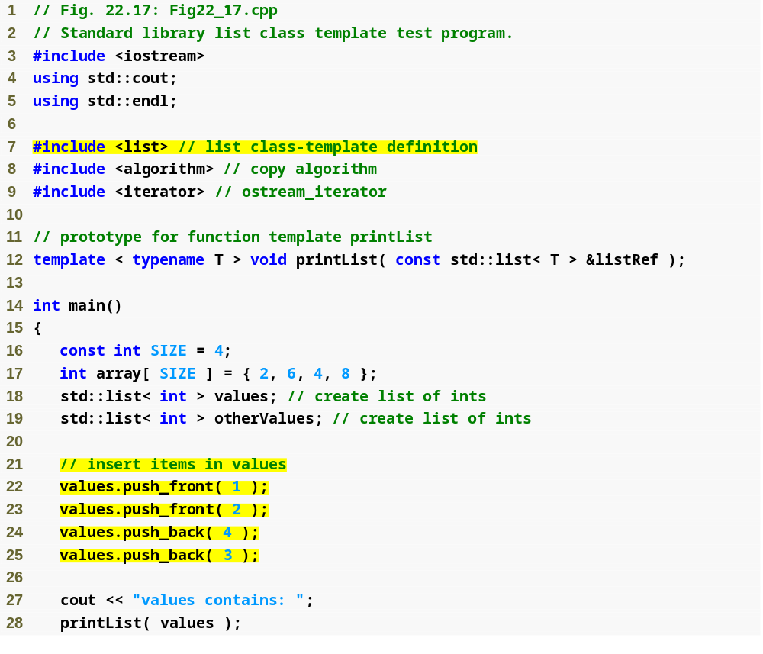
Outline
Fig22_17.cpp
(1 of 5)
Instantiate two list objects capable of storing integers
Insert integers at the beginning and end of values

Slide 80
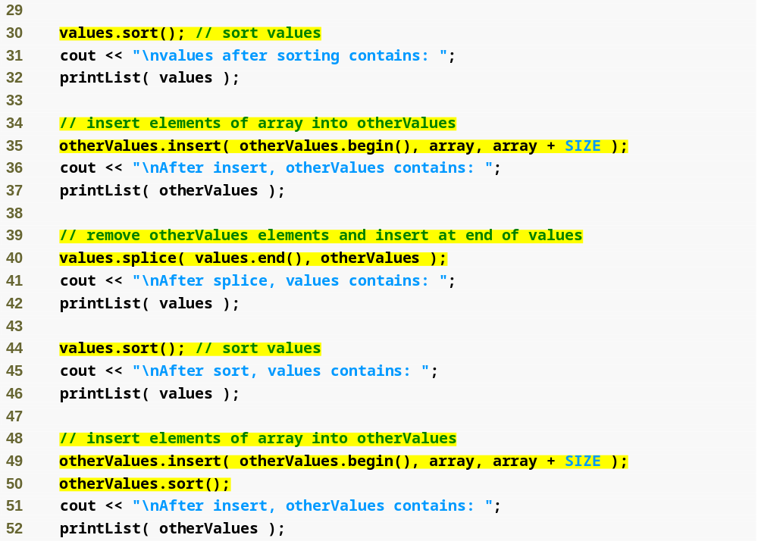
Outline
Arrange the elements in the list in ascending order
Fig22_17.cpp
(2 of 5)
Remove the elements in otherValues and insert them at the end of values

Slide 81
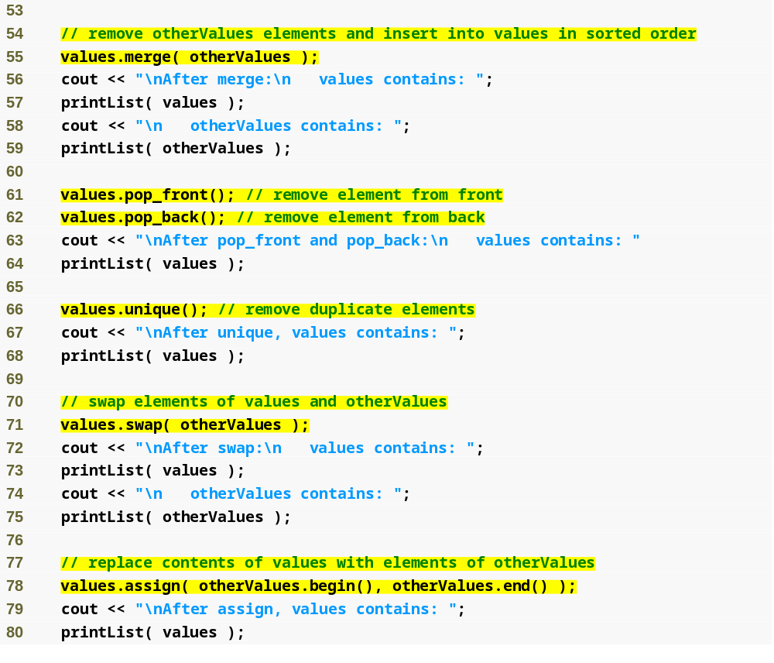
Outline
Remove all elements of otherValues and insert them in sorted order in values
Fig22_17.cpp
(3 of 5)
Remove duplicate elements in values
Exchange the contents of values with the contents of otherValues
Replace the contents of values with the elements in otherValues

Slide 82
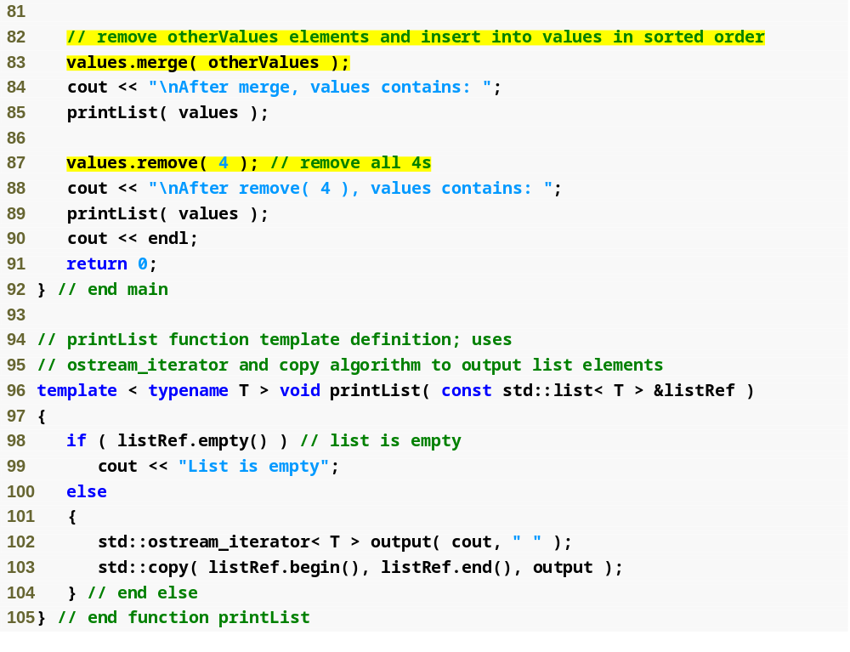
Outline
Delete all copies of the value 4 from values
Fig22_17.cpp
(4 of 5)

Slide 83
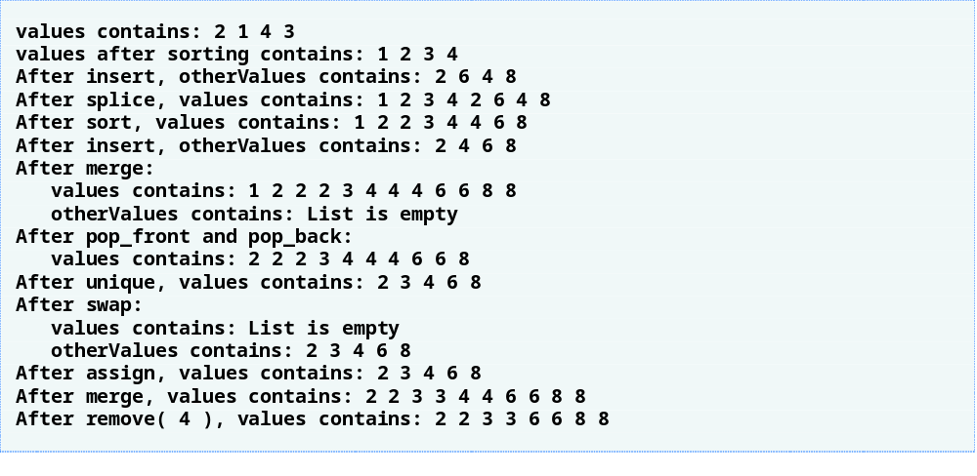
Outline
Fig22_17.cpp
(5 of 5)

Slide 84
22.2.3 deque Sequence Container
Class template deque
  Provides many of the benefits of vector and list in one container
    Efficient indexed access using subscripting
    Efficient insertion and deletion operations at front and back
  Supports random-access iterators
    All STL algorithms can be used on deques
  Additional storage may be allocated at either end
    Noncontiguous memory layout
  Requires header file <deque>

Slide 85
Performance Tip 22.13
In general, deque has slightly higher overhead than vector.

Slide 86
Performance Tip 22.14
Insertions and deletions in the middle of a deque are optimized to minimize the number of elements copied, so it is more efficient than a vector but less efficient than a list for this kind of modification.

Slide 87
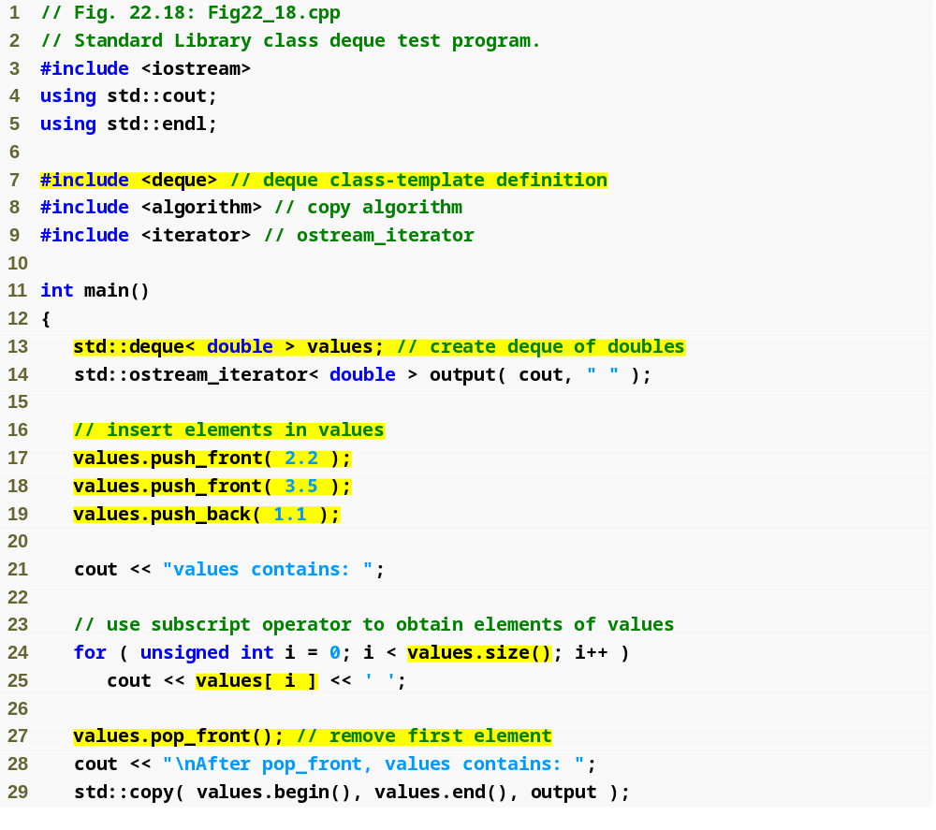
Outline
Fig22_18.cpp
(1 of 2)
Instantiate a deque that can store double values
Insert elements at the beginning and end of the deque
Retrieve the value in each element of the deque for output
Remove the first element of the deque

Slide 88
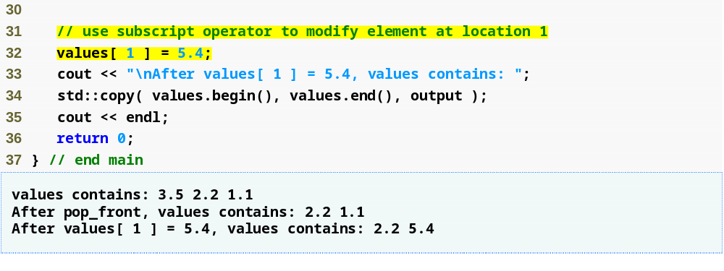
Outline
Use the subscript operator to create an lvalue
Fig22_18.cpp
(2 of 2)

Slide 89
22.3 Associative Containers
STL associative containers
  Provide direct access to store and retrieve elements via keys (often called search keys)
    Maintain keys in sorted order
  Four associative containers
    multiset – stores keys only, allows duplicates
    set – stores keys only, no duplicates
    multimap – stores keys and associated values, allows duplicates
    map – stores keys and associated values, no duplicates
  Common member functions
    find, lower_bound, upper_bound, count

Slide 90
22.3.1 multiset Associative Container
multiset associative container
  Fast storage and retrieval of keys
  Allows duplicate keys
  Ordering of keys is determined by a comparator function object
    Default is std::less< T > for ascending order
    Data type of the keys must support this function
  Supports bidirectional iterators
  Requires header file <set>

Slide 91
Good Programming Practice 22.1
Use typedefs to make code with long type names (such as multisets) easier to read.

Slide 92
22.3.1 multiset Associative Container (Cont.)
multiset associative container (Cont.)
  Member function insert
    Adds a value to a set or multiset
    Overloaded versions
      Second version – an iterator argument specifies the location to begin searching for the insertion point
      Third version – two iterator arguments specify a range of values to add from another container
  Member function find
    Locates a value in the associative container
      Returns an iterator to its earliest occurrence
      Returns the iterator returned by end if the value is not found

Slide 93
22.3.1 multiset Associative Container (Cont.)
multiset associative container (Cont.)
  Member function lower_bound
    Locates earliest occurrence of a value
      Returns an iterator to that position
      Returns the iterator returned by end if the value is not found
  Member function upper_bound
    Locates element after the last occurrence of a value
      Returns an iterator to that position
      Returns the iterator returned by end if the value is not found

Slide 94
22.3.1 multiset Associative Container (Cont.)
multiset associative container (Cont.)
  Member function equal_range
    Returns pair object containing the results of lower_bound and upper_bound
      pair data member first stores lower_bound
      pair data member second stores upper_bound

Slide 95
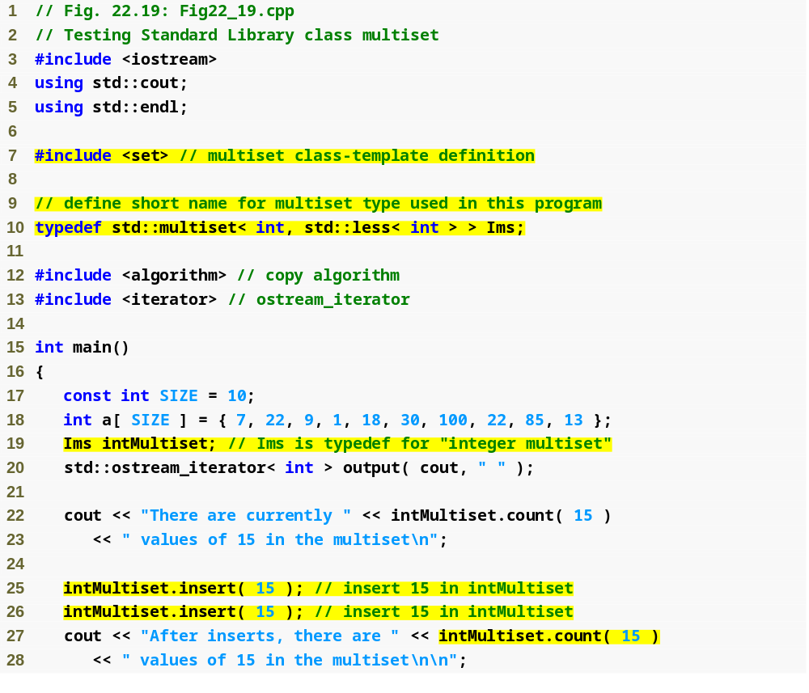
Outline
Fig22_19.cpp
(1 of 3)
Create a new type name for a multiset of integers in ascending order
Count the number of occurrences of the value 15 in intMultiset
Add the value 15 to intMultiset twice

Slide 96
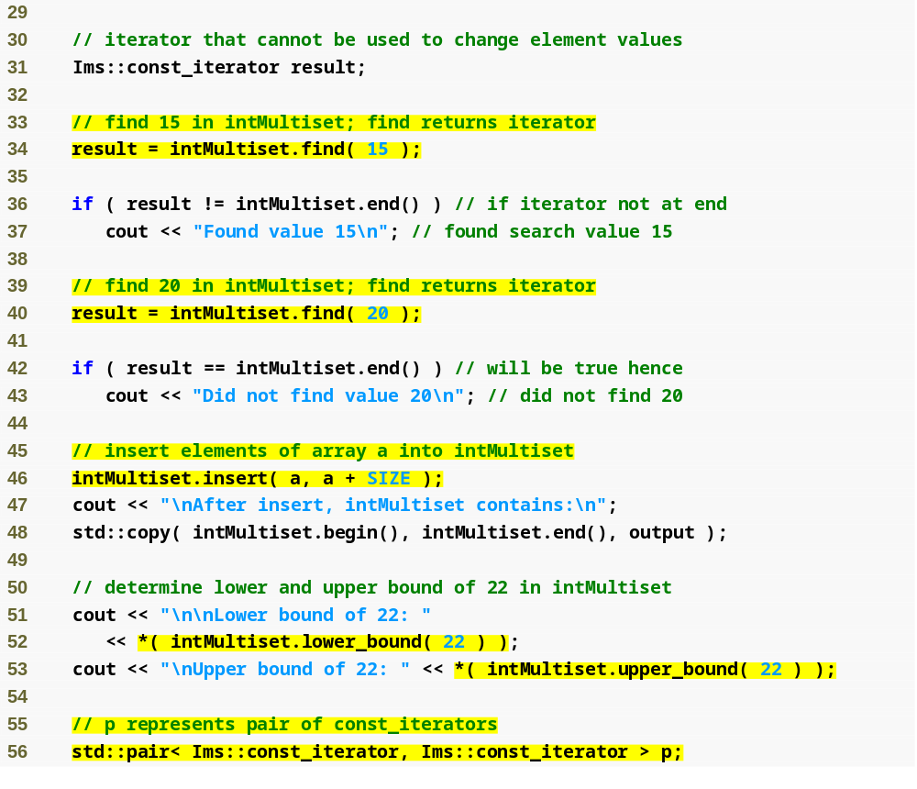
Outline
Locate the value 15 in intMultiset
Fig22_19.cpp
(2 of 3)
Insert the elements of array a into intMultiset
Locate the earliest occurrence of the value 22 in intMultiset
Locate the position after the last occurrence of the value 22 in intMultiset

Slide 97
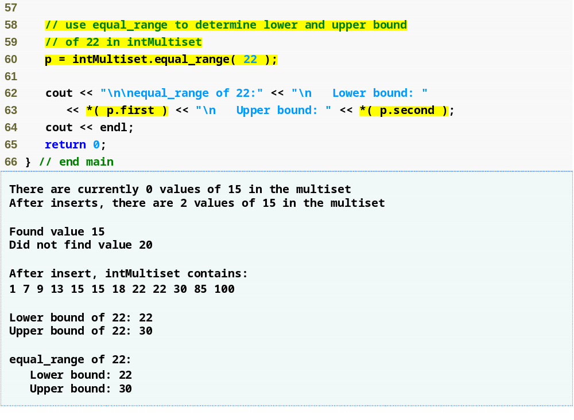
Outline
Obtain the results of both a lower_bound and an upper_bound operation from a single function call
Fig22_19.cpp
(3 of 3)
A pair contains two public data members, first and second

Slide 98
22.3.2 set Associative Container
set associative container
  Fast storage and retrieval of unique keys
    An attempt to insert a duplicate key is ignored
  Supports bidirectional iterators
  Requires header file <set>
  Member function insert
    Inserts a value into the set
    Returns a pair object
      pair member first is an iterator pointing to the element with that value inside the set
      pair member second is a bool indicating whether the value was inserted

Slide 99
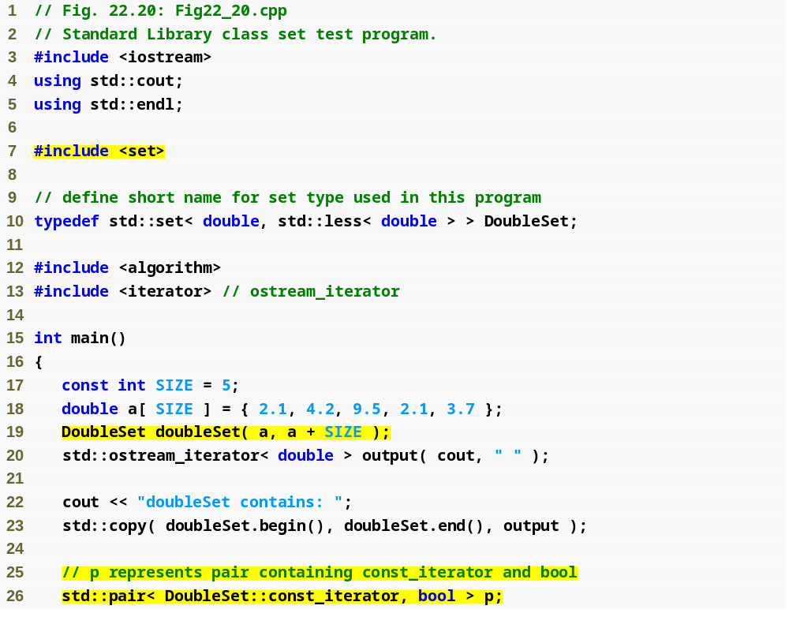
Outline
Fig22_20.cpp
(1 of 2)
Create a new type name for a set of double values ordered in ascending order
Second 2.1 value (a duplicate) will be ignored
Define a pair object to store the result of set member function insert

Slide 100
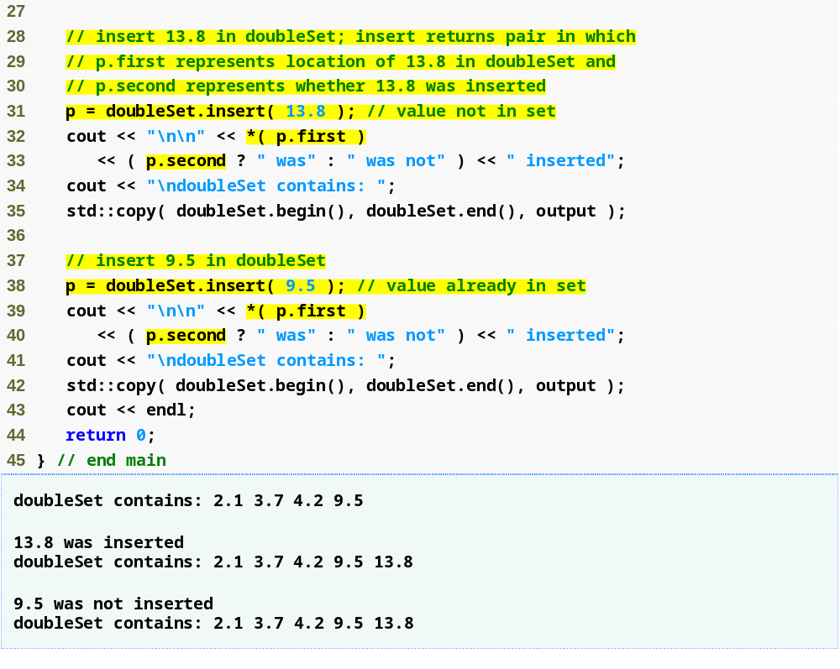
Outline
Iterator p.first points to the value 13.8 in the set
Fig22_20.cpp
(2 of 2)
bool value p.second is true if the value was inserted

Slide 101
22.3.3 multimap Associative Container
multimap associative container
  Used for fast storage and retrieval of keys and associated values (key/value pairs)
    Stored as pair objects
    Duplicate keys are allowed (one-to-many mapping)
      Multiple values can be associated with a single key
  Ordering of keys is determined by a comparator function object
  Supports bidirectional iterators
  Requires header file <map>

Slide 102
Performance Tip 22.15
A multimap is implemented to efficiently locate all values paired with a given key.

Slide 103
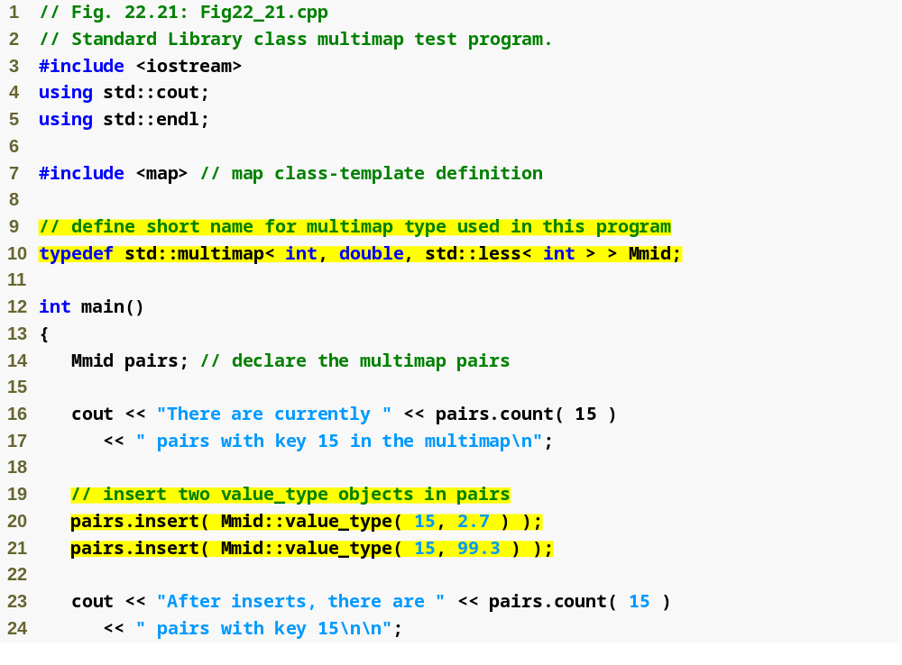
Outline
Define an alias for a multimap type with int keys and double values, in ascending order
Fig22_21.cpp
(1 of 2)
Determine the number of key/value pairs with a key of 15
Add new key/value pairs to the multimap
Create a pair object in which first is the int key 15 and second is the double value 2.7

Slide 104
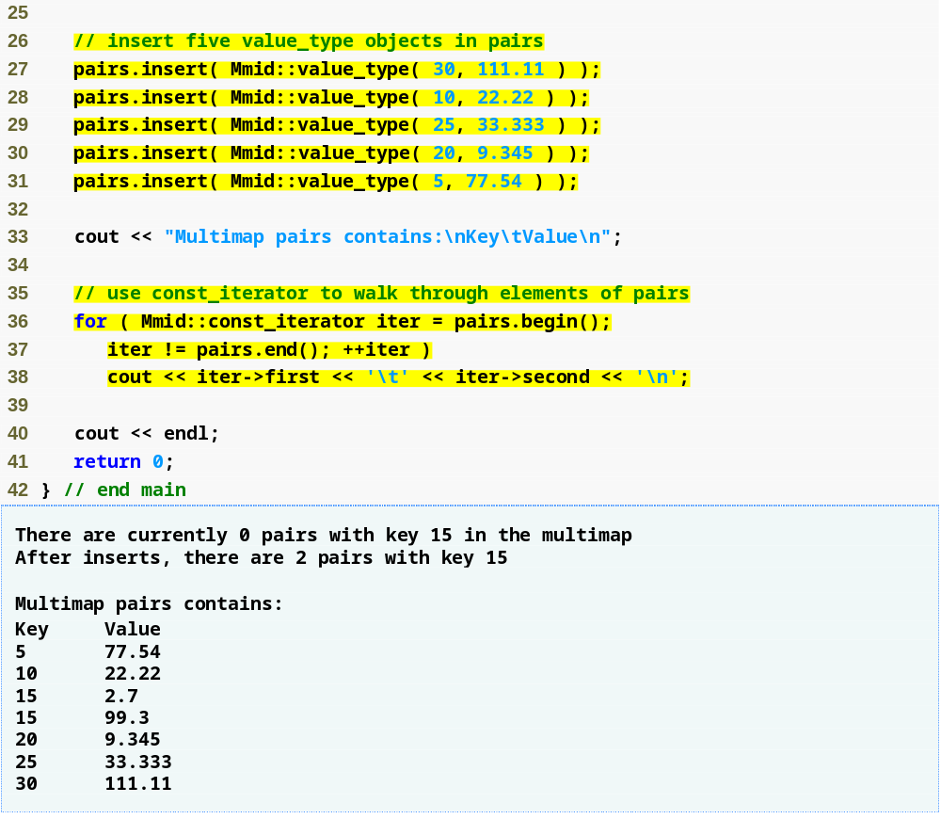
Outline
Fig22_21.cpp
(2 of 2)
Use const_iterator iter to access the keys and values in pairs

Slide 105
22.3.4 map Associative Container
map associative container
  Fast storage and retrieval of keys and associated values (key/value pairs)
    Stored as pair objects
    Duplicate keys not allowed (one-to-one mapping)
      Only one value can be associated with each key
  Commonly called an associative array
    Inserting a new key/value pair creates an association
  Insertions and deletions can be made anywhere
  Requires header file <map>

Slide 106
22.3.4 map Associative Container (Cont.)
map associative container (Cont.)
  Subscript operator [] can locate the value associated with a given key
    When the key is already in the map
      Returns a reference to the associated value
    When the key is not in the map
      Inserts the key in the map
      Returns a reference to the associated value (so it can be set)

Slide 107
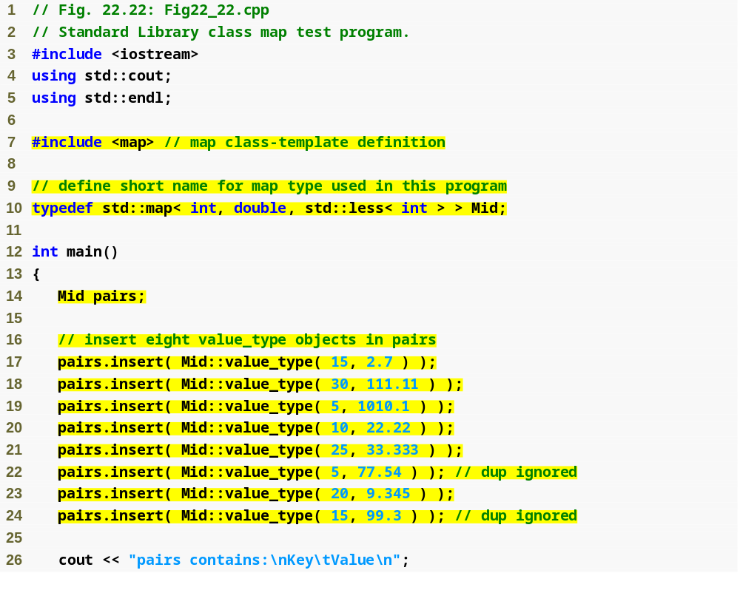
Outline
Fig22_22.cpp
(1 of 3)

Slide 108
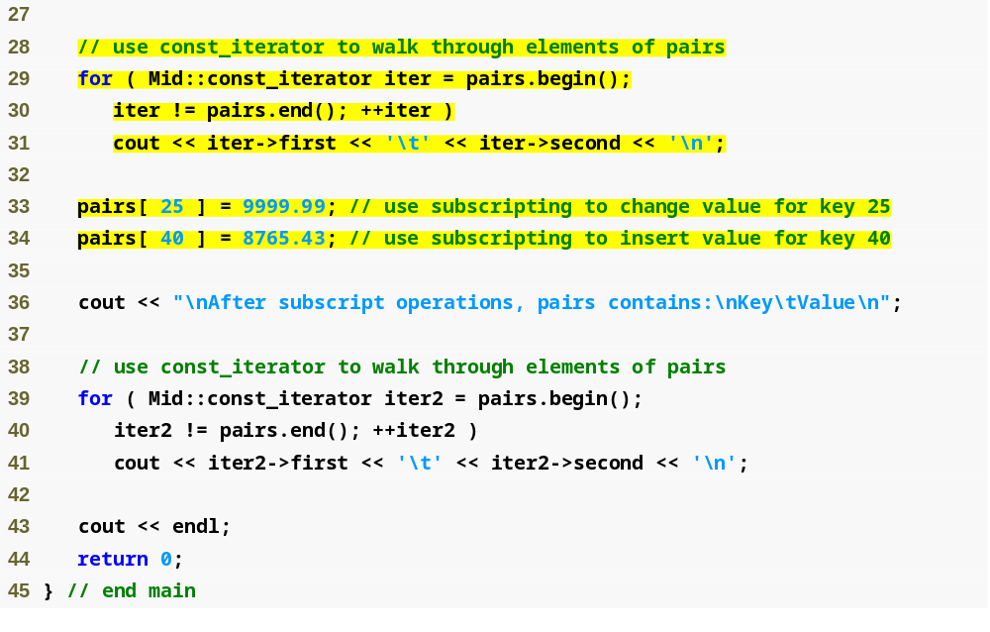
Outline
Replace the value for the key 25 with the new value 9999.99
Fig22_22.cpp
(2 of 3)
Insert a new key/value pair in the map

Slide 109
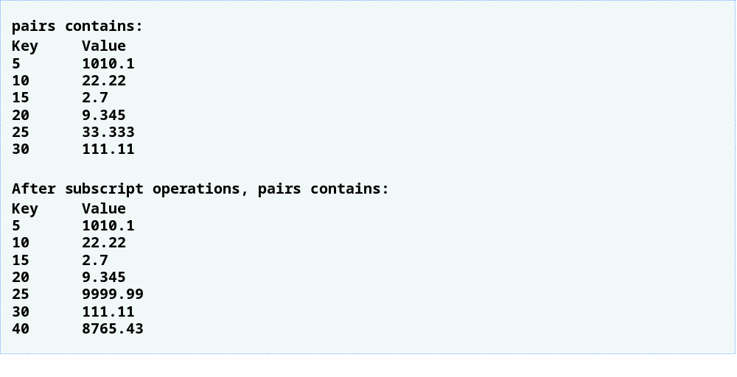
Outline
Fig22_22.cpp
(3 of 3)

Slide 110
22.4 Container Adapters
STL container adapters
  Are not first-class containers
    Do not provide the actual data structure implementation
    Do not support iterators
  You can choose an appropriate underlying data structure
  Common member functions
    push
      Properly insert an element into data structure
    pop
      Properly remove an element from data structure

Slide 111
22.4.1 stack Adapter
Class stack
  Enables insertions and deletions at one end
    Last-in, first-out data structure
  Can be implemented with any sequence container
    Vector is the default
  Operations (call functions of the underlying container)
    push – insert element at top (calls push_back)
    pop – remove top element (calls pop_back)
    top – returns reference to top element (calls back)
    empty – determine if the stack is empty (calls empty)
    size – get the number of elements (calls size)
  Requires header file <stack>

Slide 112
Performance Tip 22.16
Each of the common operations of a stack is implemented as an inline function that calls the appropriate function of the underlying container. This avoids the overhead of a second function call.

Slide 113
Performance Tip 22.17
For the best performance, use class vector as the underlying container for a stack.

Slide 114
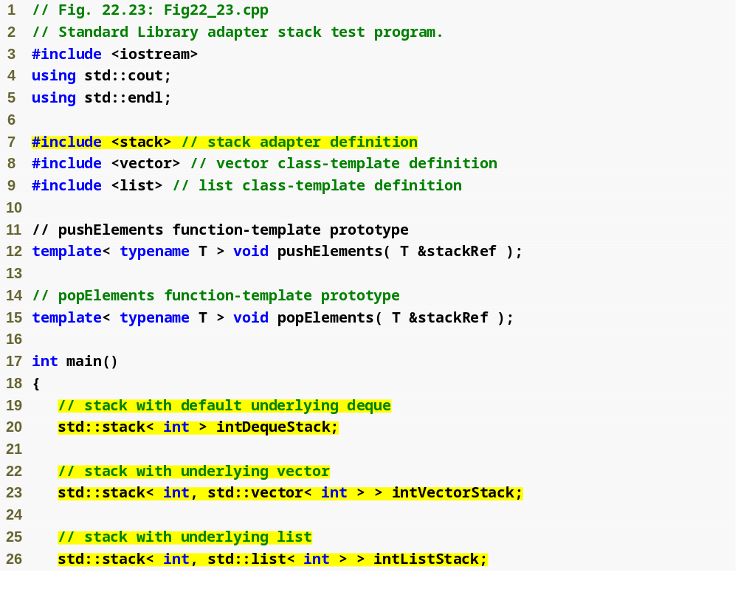
Outline
Fig22_23.cpp
(1 of 3)
Specify integer stacks using each of the three sequence containers as the underlying data structure

Slide 115
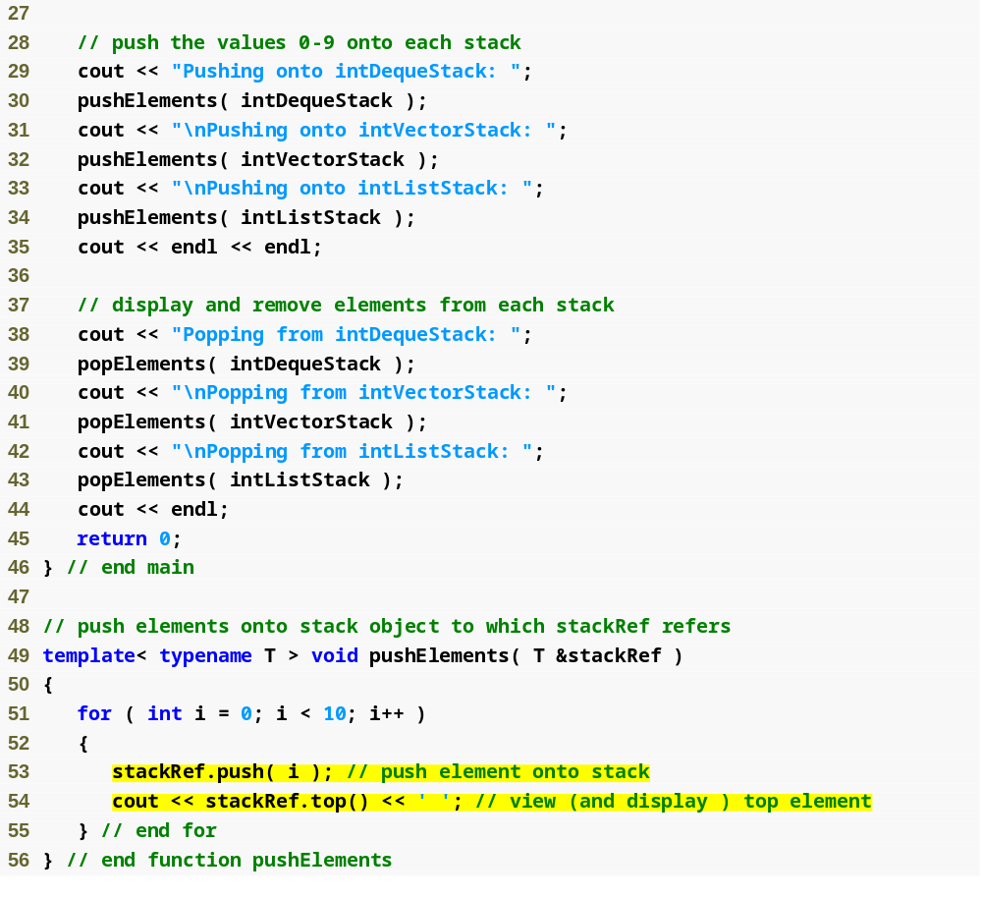
Outline
Fig22_23.cpp
(2 of 3)
Place an integer on top of the stack
Retrieve, but not remove, the top element

Slide 116
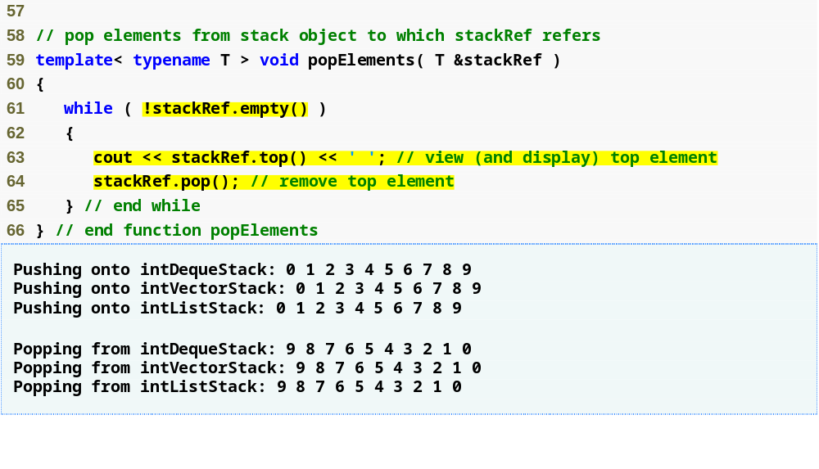
Outline
Retrieve and display the top element
Fig22_23.cpp
(3 of 3)
Remove, and discard, the top element

Slide 117
22.4.2 queue Adapter
Class queue
  Enables insertions at back and deletions from front
    First-in, first-out data structure
  Can be implemented with data structure list or deque
    deque is the default
  Operations (call functions of the underlying container)
    push – insert element at back (calls push_back)
    pop – remove element from front (calls pop_front)
    front – returns reference to first element (calls front)
    empty – determine if the queue is empty (calls empty)
    size – get the number of elements (calls size)
  Requires header file <queue>

Slide 118
Performance Tip 22.18
Each of the common operations of a queue is implemented as an inline function that calls the appropriate function of the underlying container. This avoids the overhead of a second function call.

Slide 119
Performance Tip 22.19
For the best performance, use class deque as the underlying container for a queue.

Slide 120
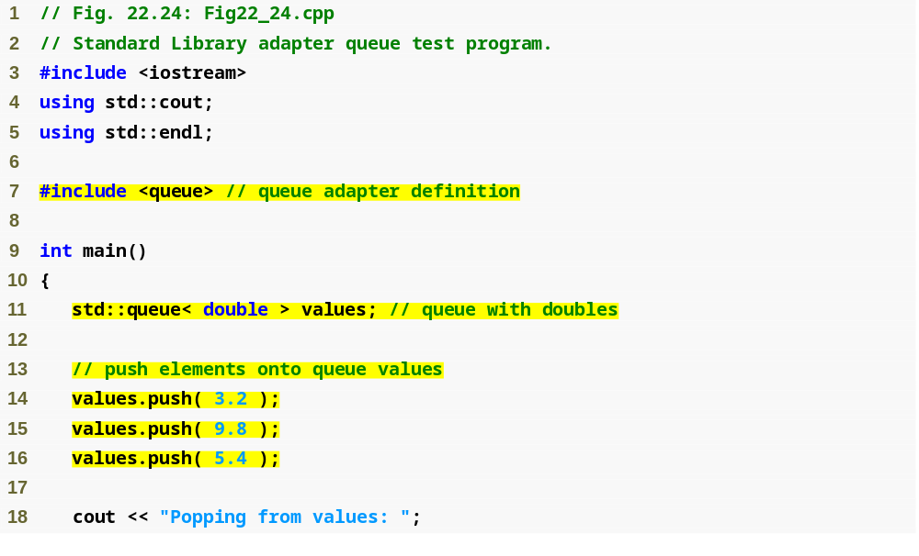
Outline
Fig22_24.cpp
(1 of 2)
Instantiate a queue that stores double values
Add elements to the queue

Slide 121
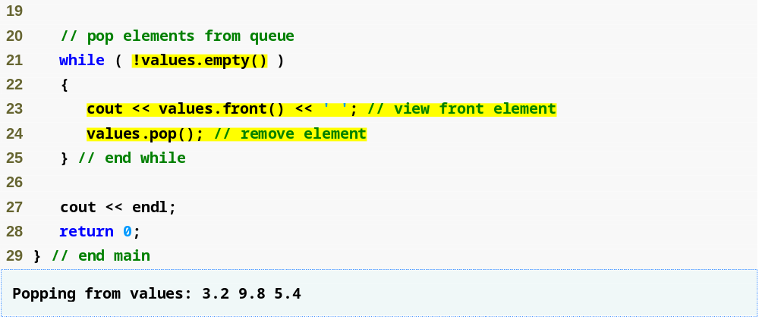
Read the first element in the queue for output
Outline
Fig22_24.cpp
(2 of 2)
Remove the first element in the queue

Slide 122
22.4.3 priority_queue Adapter
Class priority_queue
  Enables insertions in sorted order and deletions from front
    Elements are inserted in priority order
    Highest-priority element will be the first to be removed
    Maintains sorted order via heapsort
      Heaps keep largest value at the front
      Comparison of elements is performed with comparator function object less< T > by default
  Can be implemented with data structure vector or deque
    vector is the default

Slide 123
22.4.3 priority_queue Adapter (Cont.)
Class priority_queue (Cont.)
  Operations (call functions of the underlying container)
    push – insert element at appropriate location to maintain sorted order (calls push_back, then reorders elements with heapsort)
    pop – remove highest-priority element (moves top element of heap to back, then calls pop_back)
    top – returns reference to top element (calls front)
    empty – determine if the priority_queue is empty (calls empty)
    size – get the number of elements (calls size)
  Requires header file <queue>

Slide 124
Performance Tip 22.20
Each of the common operations of a priority_queue is implemented as an inline function that calls the appropriate function of the underlying container. This avoids the overhead of a second function call.

Slide 125
Performance Tip 22.21
For the best performance, use class vector as the underlying container for a priority_queue.

Slide 126
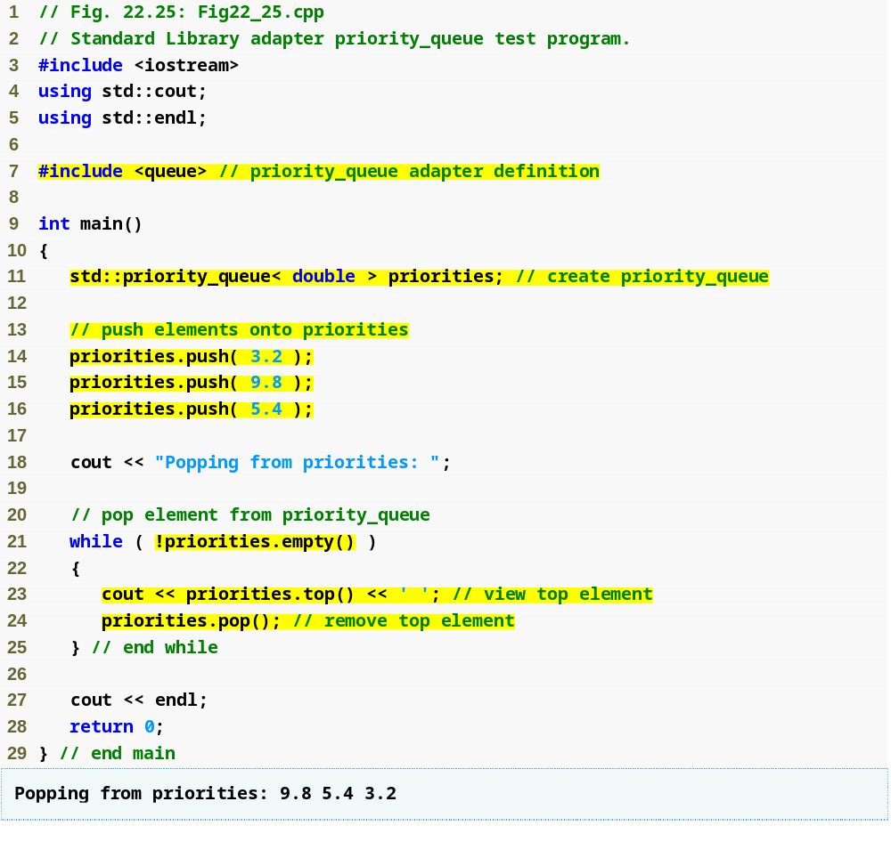
Outline
Instantiate a priority_queue that stores double values using a vector as the underlying data structure
Fig22_25.cpp
(1 of 1)
Add elements to the priority_queue
Retrieve the highest-priority element in the priority_queue for output
Remove the highest-priority element in the priority_queue

Slide 127
22.5 Algorithms
STL algorithms
  STL separates algorithms from the containers
    Elements of containers are accessed through iterators
    Much easier to add new algorithms

Slide 128
Performance Tip 22.22
The STL is implemented for efficiency. It avoids the overhead of virtual function calls.

Slide 129
Software Engineering Observation 22.8
STL algorithms do not depend on the implementation details of the containers on which they operate. As long as the container’s (or array’s) iterators satisfy the requirements of the algorithm, STL algorithms can work on C-style, pointer-based arrays, on STL containers and on user-defined data structures.

Slide 130
Software Engineering Observation 22.9
Algorithms can be added easily to the STL without modifying the container classes.

Slide 131
22.5.1 fill, fill_n, generate and generate_n
STL algorithm function fill
  Sets every element in a range of container elements to a specific value
    First and second arguments are iterators specifying the range
      Must be at least forward iterators
    Third argument is the value to set
STL algorithm function fill_n
  Sets a specified number of container elements to a specific value
    First argument is iterator specifying beginning of range
      Must be at least forward iterator
    Second argument specifies number of elements to fill
    Third argument is the value to set

Slide 132
22.5.1 fill, fill_n, generate and generate_n (Cont.)
STL algorithm function generate
  Uses generator function to create values for every element in a range of a container
    First and second arguments are iterators specifying the range
      Must be at least forward iterators
    Third argument is a pointer to a function
      This function should takes no arguments and return an element value

Slide 133
22.5.1 fill, fill_n, generate and generate_n (Cont.)
STL algorithm function generate_n
  Uses generator function to create values for a specified number of container elements
    First argument is iterator specifying beginning of range
      Must be at least forward iterator
    Second argument specifies number of elements to fill
    Third argument is a pointer to a function
      This function should takes no arguments and return an element value

Slide 134
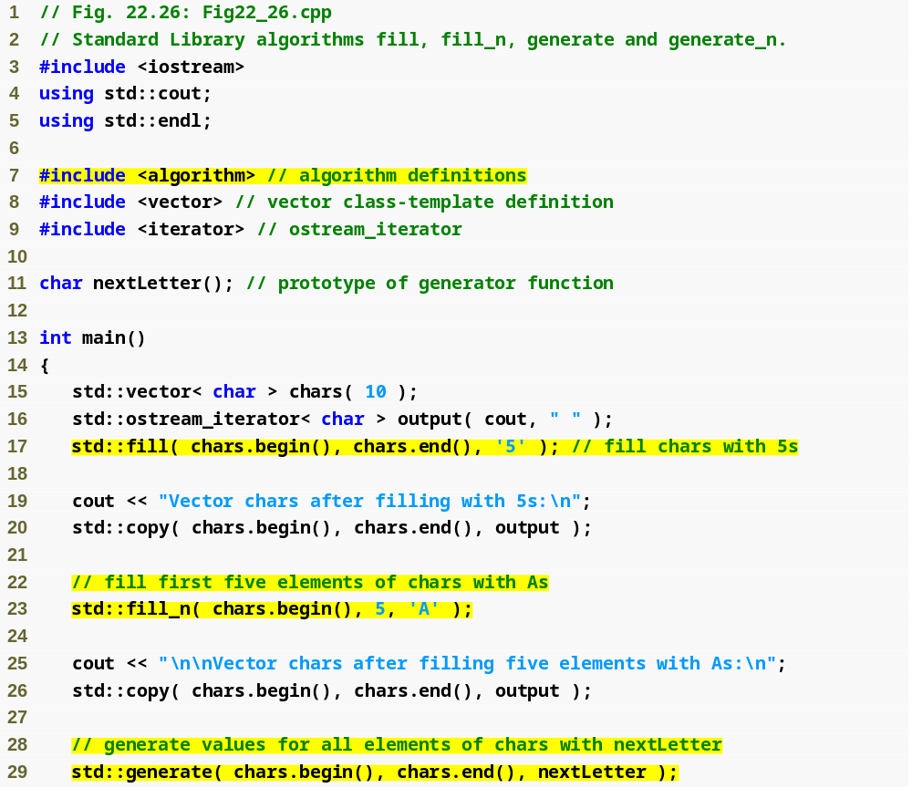
Outline
Fig22_26.cpp
(1 of 2)
Define a 10-element vector that stores char values
Place the character '5' in every element of chars
Place the character 'A' in the first five elements of chars
Place the result of a call to generator function nextLetter in every element of chars

Slide 135
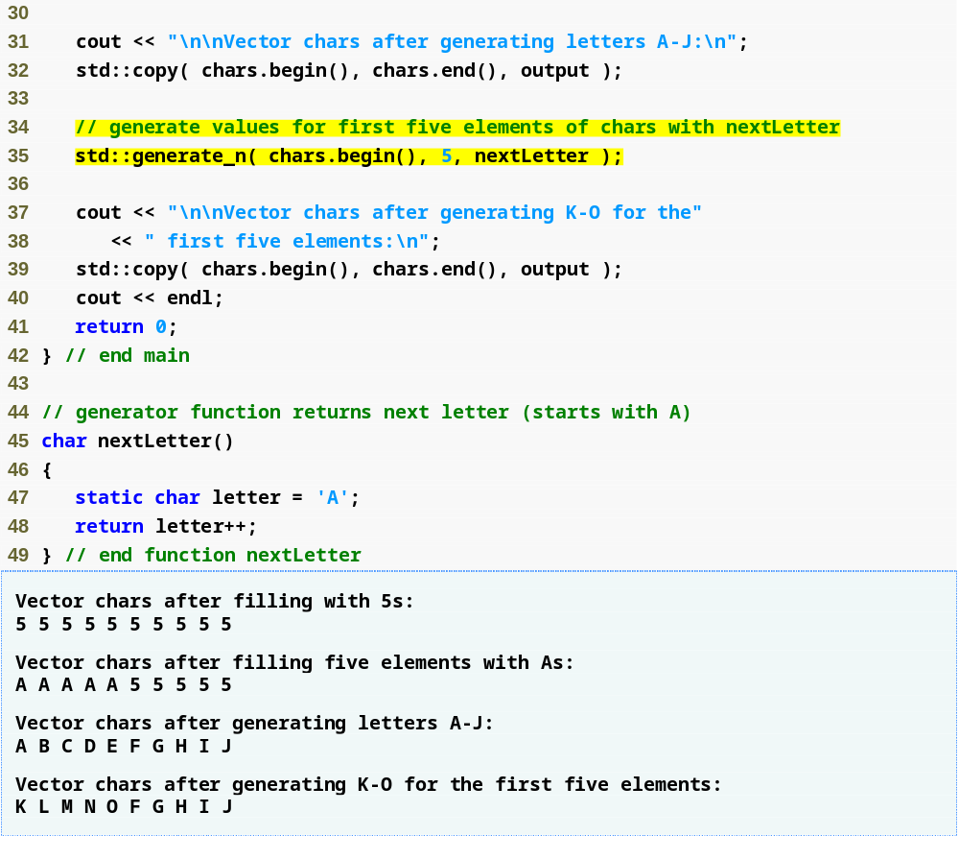
Outline
Fig22_26.cpp
(2 of 2)
Place the result of a call to generator function nextLetter in the first five elements of chars

Slide 136
22.5.2 equal, mismatch and lexicographical_compare
STL algorithm function equal
  Compares two sequences of values for equality
    Iterator arguments
      First and second arguments specify first sequence
      Third argument specifies beginning of second sequence
      Must be at least input iterators
  Considers sequences of uneven length to be unequal
  Uses == operator to compare elements
    A fourth argument can specify a binary predicate function to use instead
      Takes two element arguments and returns a bool

Slide 137
22.5.2 equal, mismatch and lexicographical_compare (Cont.)
STL algorithm function mismatch
  Locates the earliest pair of corresponding elements in two sequences that do not match
    Returns a pair of iterators indicating the mismatched elements
    Iterator arguments
      First and second arguments specify first sequence
      Third argument specifies beginning of second sequence
      Must be at least input iterators
    If all elements match, the returned pair of iterators are the last iterators for each sequence
  A fourth argument can specify a binary predicate function
    Takes two elements arguments and returns a bool

Slide 138
22.5.2 equal, mismatch and lexicographical_compare (Cont.)
STL algorithm function lexicographical_compare
  Compares the contents of two sequences
    Iterator arguments
      First and second arguments specify first sequence
      Third and fourth argument specify second sequence
      Must be at least input iterators
    Returns true if first sequence is less than second sequence
    Returns false if first sequence is greater than or equal to second sequence

Slide 139
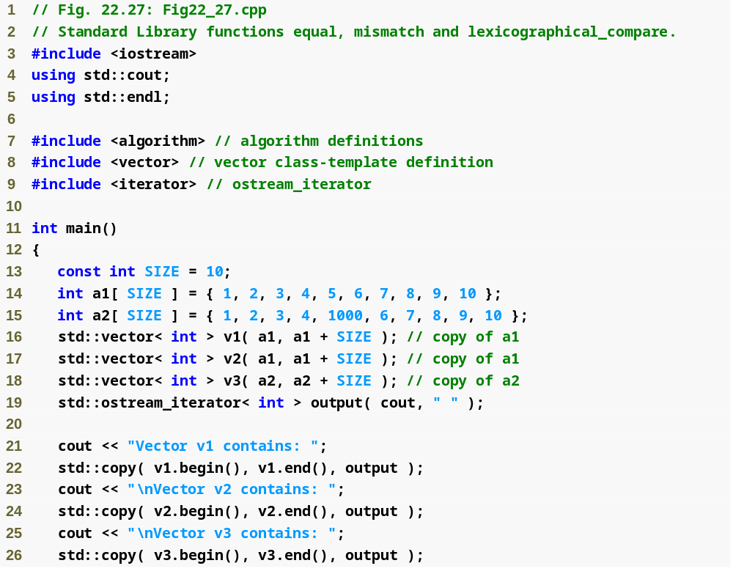
Outline
Fig22_27.cpp
(1 of 3)

Slide 140
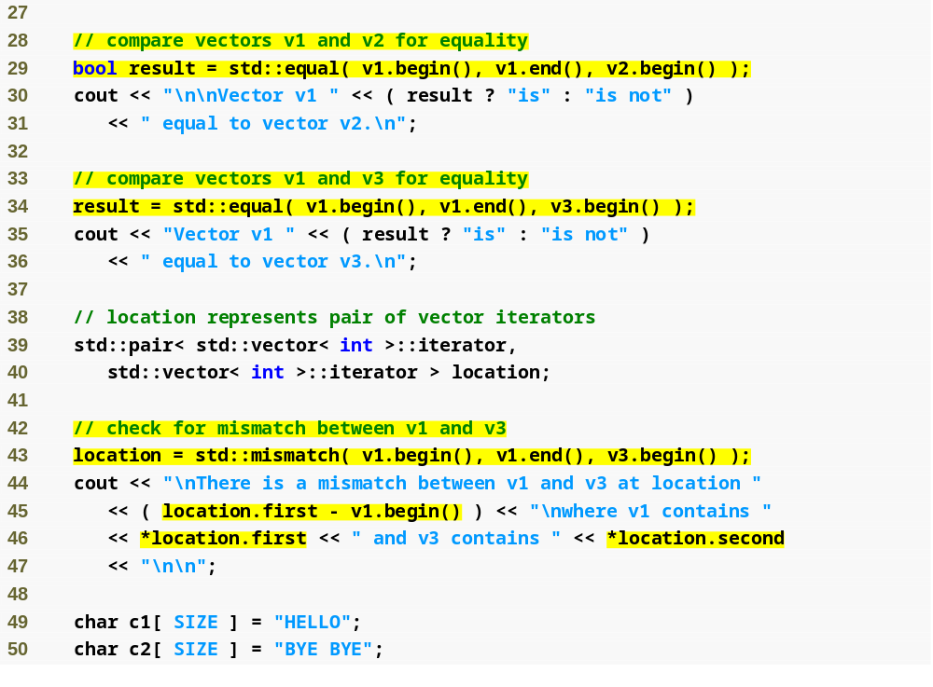
Outline
Compare v1 and v2 for equality
Fig22_27.cpp
(2 of 3)
Compare v1 and v3 for equality
Locate the mismatched elements in v1 and v3
Determine the actual location of the mismatch relative to the beginning of the vectors

Slide 141

Outline
Compare the contents of c1 and c2
Fig22_27.cpp
(3 of 3)
Pointers into arrays can be used as random-access iterators

Slide 142
22.5.3 remove, remove_if, remove_copy and remove_copy_if
STL algorithm function remove
  Eliminates all elements with a specified value in a range
    First and second iterator arguments must be at least forward iterators
    Third argument specifies value to remove
  Does not modify number of elements in the range
    Moves remaining elements toward the beginning of the range
      Returns an iterator positioned after last remaining element
        Elements after that iterator are undefined

Slide 143
22.5.3 remove, remove_if, remove_copy and remove_copy_if (Cont.)
STL algorithm function remove_copy
  Copies all elements not having a specified value from one range to another range
    First and second arguments specify source range
      Must be at least input iterators
    Third argument specifies beginning of destination range
      Must be at least output iterator
    Fourth argument specifies value not to copy
    Returns an iterator positioned after last copied element in destination range

Slide 144
22.5.3 remove, remove_if, remove_copy and remove_copy_if (Cont.)
STL algorithm function remove_if
  Eliminates all elements in a range for which a specified unary predicate function returns true
    First and second iterator arguments must be at least forward iterators
    Third argument is unary predicate function that takes an element and returns a bool
  Does not modify number of elements in the range
    Moves remaining elements toward the beginning of the range
      Returns an iterator positioned after last remaining element
        Elements after that iterator are undefined

Slide 145
22.5.3 remove, remove_if, remove_copy and remove_copy_if (Cont.)
STL algorithm function remove_copy_if
  Copies all elements for which a specified unary predicate function does not return true from one range to another range
    First and second arguments specify source range
      Must be at least input iterators
    Third argument specifies beginning of destination range
      Must be at least output iterator
    Fourth argument is unary predicate function that takes an element and returns a bool
    Returns an iterator positioned after last copied element in destination range

Slide 146

Outline
Fig22_28.cpp
(1 of 4)
Eliminate all elements with the value 10 in v

Slide 147

This vector constructor receives the number of elements in the vector and the initial value for those elements
Outline
Fig22_28.cpp
(2 of 4)
Copy all elements that do not have the value 10 from v2 to c
Delete all elements with values greater than 9 from v3

Slide 148

Outline
Fig22_28.cpp
(3 of 4)
Copy all elements that have values not greater than 9 from v4 to c2

Slide 149

Outline
Fig22_28.cpp
(4 of 4)

Slide 150
22.5.4 replace, replace_if, replace_copy and replace_copy_if
STL algorithm function replace
  Replaces all elements with a certain value in a range with a new value
    First and second iterator arguments must be at least forward iterators
    Third and fourth element arguments specify old value and new value, respectively

Slide 151
22.5.4 replace, replace_if, replace_copy and replace_copy_if (Cont.)
STL algorithm function replace_copy
  Copies all elements from one range to another range, replacing elements with a certain value with a new value
    First and second arguments specify source range
      Must be at least input iterators
    Third argument specifies beginning of destination range
      Must be at least output iterator
    Fourth and fifth element arguments specify old value and new value, respectively
    Returns an iterator positioned after last copied element in destination range

Slide 152
22.5.4 replace, replace_if, replace_copy and replace_copy_if (Cont.)
STL algorithm function replace_if
  Replaces all elements in a range for which a specified unary predicate function returns true with a new value
    First and second iterator arguments must be at least forward iterators
    Third argument specifies unary predicate function
    Fourth element argument specifies new value

Slide 153
22.5.4 replace, replace_if, replace_copy and replace_copy_if (Cont.)
STL algorithm function replace_copy_if
  Copies all elements from one range to another range, replacing elements for which a unary predicate function returns true with a new value
    First and second arguments specify source range
      Must be at least input iterators
    Third argument specifies beginning of destination range
      Must be at least output iterator
    Fourth argument specifies unary predicate function
    Fifth argument specifies new value
    Returns an iterator positioned after last copied element in destination range

Slide 154

Outline
Fig22_29.cpp
(1 of 4)
Replace all elements with the value 10 in v1 with the new value 100

Slide 155

Outline
Fig22_29.cpp
(2 of 4)
Copy all elements in v2 into c1, replacing all elements with the value 10 with the new value 100
Replace all elements in v3 that are greater than 9

Slide 156

Outline
Copy all elements in v4 into c2, replacing elements with values greater than 9 with the value 100
Fig22_29.cpp
(3 of 4)

Slide 157

Outline
Fig22_29.cpp
(4 of 4)

Slide 158
22.5.5 Mathematical Algorithms
STL algorithm function random_shuffle
  Randomly reorders elements in a specified range
    Range specified by two random-access iterator arguments
STL algorithm function count
  Count number of elements with a specified value in a specified range
    First and second iterator arguments must be at least input iterators
    Third argument specifies the element value to count

Slide 159
22.5.5 Mathematical Algorithms (Cont.)
STL algorithm function count_if
  Count number of elements for which a unary predicate function is true in a specified range
    First and second iterator arguments must be at least input iterators
    Third argument specifies the unary predicate function
STL algorithm function min_element
  Locate smallest element in a specified range
    First and second iterator arguments must be at least input iterators
    Returns forward iterator to the smallest element
      Returns the end iterator for the range if it is empty
    Can take third argument to specify a binary function to compare elements

Slide 160
22.5.5 Mathematical Algorithms (Cont.)
STL algorithm function max_element
  Locate largest element in a specified range
    First and second iterator arguments must be at least input iterators
    Returns forward iterator to the largest element
      Returns the end iterator for the range if it is empty
    Can take third argument to specify a binary function to compare elements

Slide 161
22.5.5 Mathematical Algorithms (Cont.)
STL algorithm function accumulate
  Sums the values in a specified range
    First and second iterator arguments must be at least input iterators
    Third argument represents the initial value of the total
    Can take fourth argument to specify a general accumulation function
      Takes two arguments and returns a result
        First argument is the current total
        Second argument is the current element
  Template of accumulate is in header file <numeric>

Slide 162
22.5.5 Mathematical Algorithms (Cont.)
STL algorithm function for_each
  Applies a general function to every element in a specified range
    First and second iterator arguments must be at least input iterators
    Third argument is the general function
      Takes an element as argument
      Should not modify that element

Slide 163
22.5.5 Mathematical Algorithms (Cont.)
STL algorithm function transform
  Applies a general function to every element in a specified range, storing the results in another range
    First and second iterator arguments must be at least input iterators
    Third iterator argument specifies the destination range
      Must be at least output iterator
    Fourth argument is the general function
      Takes an element as argument
      Returns the transformed value
  An overloaded version allows elements from two ranges to be transformed into a third range
    Uses binary general function

Slide 164

Outline
Fig22_30.cpp
(1 of 4)
Randomly reorder the elements in v

Slide 165

Outline
Count the elements with the value 8 in v2
Fig22_30.cpp
(2 of 4)
Count the elements in v2 whose values are greater than 9
Locate the smallest element in v2
Locate the largest element in v2
Sum the values in v
Output the square of every element in v

Slide 166

Outline
Fig22_30.cpp
(3 of 4)
Take the cube of every element in v and store them in cubes

Slide 167

Outline
Fig22_30.cpp
(4 of 4)

Slide 168
Good Programming Practice 22.2
It is a good practice to check that the range specified in a call to min_element is not empty and that the return value is not the “past the end” iterator.

Slide 169
22.5.6 Basic Searching and Sorting Algorithms
STL algorithm function find
  Locates a specified value in a specified range
    First and second iterator arguments must be at least input iterators
    Returns an input iterator positioned at the first element containing the value
      Returns an input iterator indicating the end of the range if the value is not found

Slide 170
22.5.6 Basic Searching and Sorting Algorithms (Cont.)
STL algorithm function find_if
  Locates the first value in a specified range for which a unary predicate function returns true
    First and second iterator arguments must be at least input iterators
    Returns an input iterator positioned at the first element for which the unary predicate function returns true
      Returns an input iterator indicating the end of the range if no such element is found

Slide 171
22.5.6 Basic Searching and Sorting Algorithms (Cont.)
STL algorithm function sort
  Arranges the elements in a specified range in ascending order
    First and second iterator arguments must be random-access iterators
    Can take third argument to specify a binary predicate function to indicate sorting order
      Takes two element values as arguments
      Returns true if the two elements are in sorted order

Slide 172
22.5.6 Basic Searching and Sorting Algorithms (Cont.)
STL algorithm function binary_search
  Performs a binary search for a specified value in a specified range
    First and second iterator arguments must be at least forward iterators
    Third argument specifies value to search for
    Returns a bool indicating whether the value was found
    Can take fourth argument to specify a binary predicate function to indicate sorting order
      Takes two element values as arguments
      Returns true if the two elements are in sorted order
  Values in the range must be sorted in ascending order first

Slide 173

Outline
Fig22_31.cpp
(1 of 3)
Locate the value 16 in v

Slide 174

Outline
Fig22_31.cpp
(2 of 3)
Locate the first value in v that is greater than 10
Arrange the elements in v in ascending order
Determine whether the value 13 is in v by performing a binary search

Slide 175

Outline
Fig22_31.cpp
(3 of 3)

Slide 176
Common Programming Error 22.5
Attempting to sort a container by using an iterator other than a random-access iterator is a compilation error. Function sort requires a random-access iterator.

Slide 177
22.5.7 swap, iter_swap and swap_ranges
STL algorithm function swap
  Swap two values
    Takes as arguments two references to values being swapped
STL algorithm function iter_swap
  Swap two values pointed to by iterators
    Takes as arguments two forward iterators pointing to elements whose values are being swapped

Slide 178
22.5.7 swap, iter_swap and swap_ranges (Cont.)
STL algorithm function swap_ranges
  Exchange the elements in two specified ranges
    First and second arguments specify first range
      Must be at least forward iterators
    Third argument specifies beginning of second range
      Must be at least forward iterator
  Specified ranges can be in the same container or two different containers (or arrays)

Slide 179

Outline
Fig22_32.cpp
(1 of 2)
Exchange the first and second elements of array a
Treat pointers to the first and second elements of array a as iterators

Slide 180

Outline
Exchange the first five elements of a with the next five elements of a
Fig22_32.cpp
(2 of 2)

Slide 181
22.5.8 copy_backward, merge, unique and reverse
STL algorithm function copy_backward
  Copy elements from one specified range to another range by copying backward
    First and second arguments specify source range
      Must be at least bidirectional iterators
    Third argument points one element past the last element of destination range
      Must be at least bidirectional iterator
    Begins by copying element before second argument into element before third argument
      Proceeds backwards from there (toward first argument)
    Returns iterator positioned at last element copied
      The new first element in the destination range

Slide 182
22.5.8 copy_backward, merge, unique and reverse (Cont.)
STL algorithm function merge
  Combines two sorted ascending sequences into a third sorted sequence
    First and second arguments specify first sequence
      Must be at least input iterators
    Third and fourth arguments specify second sequence
      Must be at least input iterators
    Fifth argument specifies beginning of destination sequence
      Must be at least output iterator
    Can take sixth argument to specify a binary predicate function that indicates sorting order
  Destination sequence must be at least the combined length of both source sequences

Slide 183
22.5.8 copy_backward, merge, unique and reverse (Cont.)
Function template back_inserter
  Used when the number of elements to be put into a container is not known in advance
    Takes container as argument
    Returns an iterator that will call the container’s push_back function to insert elements
    Thus, container grows in size when necessary
  In header file <iterator>
  In namespace std
  Other inserter function templates
    front_inserter is used to insert at the beginning of the container
    inserter is used to insert before the element specified in the second (iterator) argument

Slide 184
22.5.8 copy_backward, merge, unique and reverse (Cont.)
STL algorithm function unique
  Eliminates duplicates in a sorted sequence of elements
    First and second arguments specify sequence
      Must be at least forward iterators
    Can take third argument to specify a binary predicate function to compare elements for equality
    Returns an iterator positioned after last unique element
      Elements after that iterator are undefined
STL algorithm function reverse
  Reverses all elements in the specified range
    First and second arguments specify range
      Must be at least bidirectional iterators

Slide 185

Outline
Fig22_33.cpp
(1 of 3)
Copy elements in v1 into results by starting from the element before v1.end()and working toward the beginning

Slide 186

Outline
Combine sorted vectors v1 and v2 into sorted vector results2
Fig22_33.cpp
(2 of 3)
Eliminate duplicate values from results2
Reverse all elements in v1

Slide 187

Outline
Fig22_33.cpp
(3 of 3)

Slide 188
22.5.9 inplace_merge, unique_copy and reverse_copy
STL algorithm function inplace_merge
  Merges two sorted sequences of elements in the same container
    First and second arguments specify beginnings of sequences
      Must be at least bidirectional iterators
    Third argument specifies end of the entire sequence
      Must be at least bidirectional iterator
    Can take fourth argument to specify binary predicate function for comparing elements

Slide 189
22.5.9 inplace_merge, unique_copy and reverse_copy (Cont.)
STL algorithm function unique_copy
  Copies all unique elements in a sorted sequence into another sequence
    First and second arguments specify source sequence
      Must be at least input iterators
    Third argument specifies beginning of destination sequence
      Must be at least output iterator
    Can take fourth argument to specify binary predicate function to compare elements for equality

Slide 190
22.5.9 inplace_merge, unique_copy and reverse_copy (Cont.)
STL algorithm function reverse_copy
  Places a reversed copy of the elements in a specified range in another range
    First and second arguments specify source sequence
      Must be at least bidirectional iterators
    Third argument specifies beginning of destination sequence
      Must be at least output iterator

Slide 191

Outline
Fig22_34.cpp
(1 of 2)
Merge the first five elements in v1 with the remaining five elements in v1

Slide 192

Outline
Make a copy of all unique elements in v1 and place the copied elements in results1
Fig22_34.cpp
(2 of 2)
Use back_inserter to insert new elements into results1 rather than replace existing elements
Put a reversed copy of the elements in v1 into results2

Slide 193
22.5.10 Set Operations
STL algorithm function includes
  Determines whether every element of the second set is in the first set
    First and second arguments specify first set
      Must be at least input iterators
    Third and fourth arguments specify second set
      Must be at least input iterators
    Both sets must be sorted first
    Can take fifth argument – a binary predicate function to compare elements for equality

Slide 194
22.5.10 Set Operations (Cont.)
STL algorithm function set_difference
  Finds the elements from the first set that are not in the second set
    First and second arguments specify first set
      Must be at least input iterators
    Third and fourth arguments specify second set
      Must be at least input iterators
    Both sets must be sorted (with same comparison function)
    Fifth argument specifies beginning of set that will store elements that are in first set but not in second set
      Must be at least output iterator
    Returns output iterator positioned after last copied value
    Can take sixth argument – binary predicate function indicating original sorting order

Slide 195
22.5.10 Set Operations (Cont.)
STL algorithm function intersection
  Finds the elements in both the first set and the second set
    First and second arguments specify first set
      Must be at least input iterators
    Third and fourth arguments specify second set
      Must be at least input iterators
    Both sets must be sorted (with same comparison function)
    Fifth argument specifies beginning of set that will store elements that are common to both sets
      Must be at least output iterator
    Returns output iterator positioned after last copied value
    Can take sixth argument – binary predicate function indicating original sorting order

Slide 196
22.5.10 Set Operations (Cont.)
STL algorithm function set_symmetric_difference
  Finds elements in first set that are not in second set or in second set but not in first set
    First and second arguments specify first set
      Must be at least input iterators
    Third and fourth arguments specify second set
      Must be at least input iterators
    Both sets must be sorted (with same comparison function)
    Fifth argument specifies beginning of set that will store elements in only one of the two sets
      Must be at least output iterator
    Returns output iterator positioned after last copied value
    Can take sixth argument – binary predicate function indicating original sorting order

Slide 197
22.5.10 Set Operations (Cont.)
STL algorithm function union
  Create a set of all elements in either the first set or the second set, or both
    First and second arguments specify first set
      Must be at least input iterators
    Third and fourth arguments specify second set
      Must be at least input iterators
    Both sets must be sorted (with same comparison function)
    Fifth argument specifies beginning of set that will store elements found in either set or both sets
      Must be at least output iterator
    Returns output iterator positioned after last copied value
    Can take sixth argument – binary predicate function indicating original sorting order

Slide 198

Outline
Fig22_35.cpp
(1 of 3)
Determine whether every element in a2 is contained in a1

Slide 199

Outline
Fig22_35.cpp
(2 of 3)
Copy the elements in a1 that are not in a2 into difference
Store the elements common to both a1 and a2 in intersection

Slide 200

Outline
Copy the elements in a1 that are not in a3 and the elements in a3 that are not in a1 into symmetric_difference
Fig22_35.cpp
(3 of 3)
Place the combined set of all elements in a1 or a3 into unionSet

Slide 201
22.5.11 lower_bound, upper_bound and equal_range
STL algorithm function lower_bound
  Find first location in a sorted sequence where a specified value could be inserted while maintaining sorted order
    First and second arguments specify the sorted sequence
      Must be at least forward iterators
    Third argument is the value to consider inserting
    Returns forward iterator to the lower bound location
    Can take fourth argument – a binary predicate function to indicate original sorting order

Slide 202
22.5.11 lower_bound, upper_bound and equal_range (Cont.)
STL algorithm function upper_bound
  Find last location in a sorted sequence where a specified value could be inserted while maintaining sorted order
    First and second arguments specify the sorted sequence
      Must be at least forward iterators
    Third argument is the value to consider inserting
    Returns forward iterator to the upper bound location
    Can take fourth argument – a binary predicate function to indicate original sorting order

Slide 203
22.5.11 lower_bound, upper_bound and equal_range (Cont.)
STL algorithm function equal_range
  Returns pair of forward iterators containing results of both lower_bound and upper_bound operations
    First and second arguments specify the sorted sequence
      Must be at least forward iterators
    Third argument is the value to consider inserting
    Returns pair of forward iterators (lower bound in first, upper bound in second)

Slide 204

Outline
Fig22_36.cpp
(1 of 4)
Find the first location where 6 can be inserted in sorted order into vector v
Calculate the lower-bound position relative to the beginning of v

Slide 205

Outline
Find the last location where 6 can be inserted in sorted order in vector v
Fig22_36.cpp
(2 of 4)
Find the lower bound and upper bound for 6 in v using the equal_range algorithm

Slide 206

Outline
Fig22_36.cpp
(3 of 4)

Slide 207

Outline
Fig22_36.cpp
(4 of 4)

Slide 208
22.5.12 Heapsort
Heapsort sorting algorithm
  Heap
    A special binary tree
    Stored as an array of elements
    Key feature
      Largest element is always at top
      Values of child nodes are always less than or equal to parent node’s value
      Often called a maxheap

Slide 209
22.5.12 Heapsort (Cont.)
STL algorithm function make_heap
  Arranges a sequence of values into a heap
    First and second arguments specify the sequence
      Must be random-access iterators
    Can take third argument – a binary predicate function for comparing values
STL algorithm function sort_heap
  Sorts a sequence of values that is already in a heap
    First and second arguments specify the sequence
      Must be random-access iterators
    Can take third argument – a binary predicate function for comparing values

Slide 210
22.5.12 Heapsort (Cont.)
STL algorithm function push_heap
  Adds a new value into a heap
    First and second arguments specify the sequence
      Must be random-access iterators
    Can take third argument – a binary predicate function for comparing values
  Assumes that
    last element in the sequence is value being added to the heap
    All elements before last element are arranged as a heap

Slide 211
22.5.12 Heapsort (Cont.)
STL algorithm function push_heap
  Adds a new value into a heap
    First and second arguments specify the sequence
      Must be random-access iterators
    Can take third argument – a binary predicate function for comparing values
  Assumes that
    last element in the sequence is value being added to the heap
    All elements before last element are arranged as a heap

Slide 212
22.5.12 Heapsort (Cont.)
STL algorithm function pop_heap
  Removes the top element in a heap
    First and second arguments specify the sequence
      Must be random-access iterators
    Can take third argument – a binary predicate function for comparing values
  Assumes that sequence elements are arranged as a heap
  Swaps top heap element with last element in sequence
    Then rearranges remaining heap elements into a new heap
  Repeatedly removing top element of the remaining heap results in a sorted sequence in the original container area

Slide 213

Outline
Fig22_37.cpp
(1 of 4)
Arrange the elements of v into a heap
Sort the elements of v using heapsort

Slide 214

Outline
Fig22_37.cpp
(2 of 4)
Insert value a[ i ] into v2
Push value a[ i ] into the heap in v2
Remove the top heap element and place it in the j^{th}-to-last position in v2

Slide 215

Outline
Fig22_37.cpp
(3 of 4)

Slide 216

Outline
Fig22_37.cpp
(4 of 4)

Slide 217
22.5.13 min and max
STL algorithm function min
  Returns the smaller of two elements
STL algorithm function max
  Returns the larger of two elements

Slide 218

Outline
Fig22_38.cpp
(1 of 1)
Determine which of 12 and 7 is smaller
Determine which of 12 and 7 is larger
Determine which of 'G' and 'Z' is less
Determine which of 'G' and 'Z' is greater

Slide 219

Fig. 22.39 | Algorithms not covered in this chapter. (Part 1 of 5)

Slide 220

Fig. 22.39 | Algorithms not covered in this chapter. (Part 2 of 5)

Slide 221

Fig. 22.39 | Algorithms not covered in this chapter. (Part 3 of 5)

Slide 222

Fig. 22.39 | Algorithms not covered in this chapter. (Part 4 of 5)

Slide 223

Fig. 22.39 | Algorithms not covered in this chapter. (Part 5 of 5)

Slide 224
22.6 Class bitset
Class bitset
  Create and manipulate sets of bits
    Useful for representing sets of bit flags
  Fixed in size at compile time
  Example
    bitset< size > b;
      Creates bitset b
        Contains size number of bits, all initially 0
  Member function set
    Sets a specified bit to “on”
    Sets all bits to “on” if no argument is specified

Slide 225
22.6 Class bitset (Cont.)
Class bitset (Cont.)
  Member function reset
    Sets a specified bit to “off”
    Sets all bits to “off” if no argument is specified
  Member function flip
    “Flips” a specified bit (on to off, off to on)
    Flips all bits if no argument is specified
  Subscript operator []
    Returns a reference to a specified bit

Slide 226
22.6 Class bitset (Cont.)
Class bitset (Cont.)
  Member function at
    Returns a reference to a specified bit
    Performs range-checking
      Throws an out_of_range exception
  Member function test
    Returns true if a specified bit is on or false if it is off
    Performs range-checking
      Throws an out_of_range exception
  Member function size
    Returns the number of bits in the bitset

Slide 227
22.6 Class bitset (Cont.)
Class bitset (Cont.)
  Member function count
    Returns the number of bits that are set in the bitset
  Member function any
    Returns true if any bit is set in the bitset
  Member function none
    Returns true if none of the bits is set in the bitset
  Equality operator == and inequality operator !=
    Compare two bitsets for equality and inequality, respectively

Slide 228
22.6 Class bitset (Cont.)
Class bitset (Cont.)
  Bitwise assignment operator &=, |= and ^=
    Used to combine bitsets
      Bit-by-bit logical AND with &=
      Bit-by-bit logical OR with |=
      Bit-by-bit logical XOR with ^=
  Bitwise shift operators >>= and <<=
    Shift the bits in a bitset to the right and left, respectively
  Member functions to_string and to_ulong
    Convert the bitset to a string and an unsigned long, respectively

Slide 229

Outline
Fig22_40.cpp
(1 of 4)
Create a bitset of 1024 bits, all set to “off” by default
Flip all bits to “on”
0 and 1 are not prime numbers
Determine when the algorithm should terminate

Slide 230

Outline
If i is a prime number
Fig22_40.cpp
(2 of 4)
All numbers that are multiples of i are not prime numbers
Check if k is a prime number

Slide 231

Outline
Check if value is a prime number
Fig22_40.cpp
(3 of 4)

Slide 232

Outline
Fig22_40.cpp
(4 of 4)

Slide 233
22.7 Function Objects
Function object
  An object of a class that overloads the parentheses operator
    With a function named operator()
  Can be used syntactically and semantically like a function or function pointer
    Can be passed to an STL algorithm that takes a function pointer
  Advantages over function pointers
    Overloaded operator() can be inlined to improve performance
    Can utilize class data members in performing tasks
  Many predefined function objects are in <functional>

Slide 234

Fig. 22.41 | Function objects in the Standard Library

Slide 235

Outline
Fig22_42.cpp
(1 of 3)
Define function sumSquares

Slide 236

Outline
Fig22_42.cpp
(2 of 3)
Define class SumSquaresClass which will be used to instantiate function objects
Pass a pointer to function sumSquares to accumulate

Slide 237

Outline
Fig22_42.cpp
(3 of 3)
Pass an instance of class SumSquaresClass (a function object) to accumulate

Slide 238
22.9 STL Web Resources
C++ Resource Center
  www.deitel.com/cplusplus/

